Slide 1
YEAR-IN-REVIEW
2019
12TH ANNUAL
by POTOMAC RIVER PARTNERS
START >

Slide 2
Drug pricing remains a focus at federal and state levels
12TH ANNUAL YEAR-IN-REVIEW 2019
POTOMACRIVERPARTNERS.COM

Slide 3
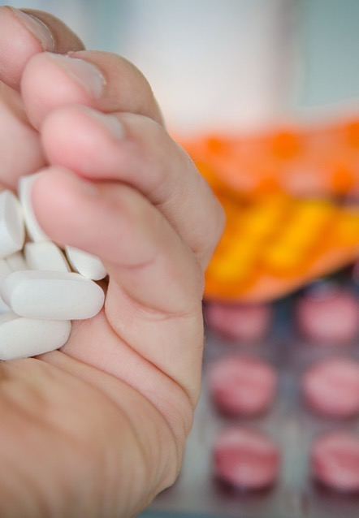
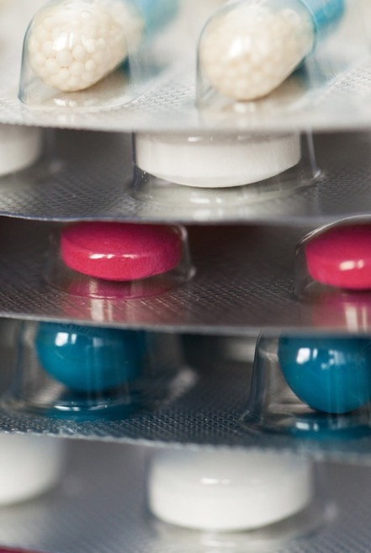
States and municipalities target opioids
12TH ANNUAL YEAR-IN-REVIEW 2019
POTOMACRIVERPARTNERS.COM

Slide 4
Co-pay settlements with 3 foundations and 6 manufacturers
12TH ANNUAL YEAR-IN-REVIEW 2019
POTOMACRIVERPARTNERS.COM

Slide 5
US FEDERAL SETTLEMENTS
12TH ANNUAL YEAR-IN-REVIEW 2019
POTOMACRIVERPARTNERS.COM

Slide 6
FEDERAL SETTLEMENTS
False Claims Act (FCA)
Co-Pay Allegations
DONORS

Slide 7
FEDERAL SETTLEMENTS
FCA Co-Pay Allegations
DONORS
Jazz Pharmaceuticals*:
$57 million
*Entered into CIA

Slide 8
FEDERAL SETTLEMENTS
FCA Co-Pay Allegations
DONORS
Lundbeck*:
$52.6 million
*Entered into CIA

Slide 9
FEDERAL SETTLEMENTS
FCA Co-Pay Allegations
DONORS
Alexion:
$13 million

Slide 10
FEDERAL SETTLEMENTS
FCA Co-Pay Allegations
DONORS
Astellas*:
$100 million
*Entered into CIA

Slide 11
FEDERAL SETTLEMENTS
FCA Co-Pay Allegations
DONORS
Amgen*:
$24.5 million
*Entered into CIA

Slide 12
FEDERAL SETTLEMENTS
FCA Co-Pay Allegations
DONORS
US WorldMeds*:
$17.5 million
(includes other kickback allegations)
*Entered into CIA

Slide 13
FEDERAL SETTLEMENTS
FCA Co-Pay Allegations Summary
DONORS
Jazz Pharmaceuticals*:
$57 million
Lundbeck*:
$52.6 million
Alexion:
$13 million
Astellas*:
$100 million
Amgen*:
$24.5 million
US WorldMeds*:
$17.5 million
*Entered into a CIA

Slide 14
FEDERAL SETTLEMENTS
FCA Co-Pay Allegations
FOUNDATIONS

Slide 15
FEDERAL SETTLEMENTS
FCA Co-Pay Allegations
FOUNDATIONS
Chronic Disease Fund (“Good Days”)*: $2 million
*Entered into Integrity Agreement

Slide 16
FEDERAL SETTLEMENTS
FCA Co-Pay Allegations
FOUNDATIONS
Patient Access Network Foundation*:
$4 million
*Entered into Integrity Agreement

Slide 17
FEDERAL SETTLEMENTS
FCA Co-Pay Allegations
FOUNDATIONS
The Assistance Fund*:
$4 million
*Entered into Integrity Agreement

Slide 18
FEDERAL SETTLEMENTS
FCA Co-Pay Allegations Summary
FOUNDATIONS
Chronic Disease Fund
(“Good Days”):
$2 million
Patient Access Network Foundation:
$4 million
The Assistance Fund:
$4 million
All entered into Integrity Agreements

Slide 19
FEDERAL SETTLEMENTS
KICKBACK ALLEGATIONS

Slide 20
FEDERAL SETTLEMENTS
KICKBACK ALLEGATIONS
Avanir*:
$108 million
*Entered into CIA

Slide 21
FEDERAL SETTLEMENTS
KICKBACK ALLEGATIONS
Covidien:
$17 million

Slide 22
FEDERAL SETTLEMENTS
KICKBACK ALLEGATIONS
Mallinckrodt:
$15.4 million

Slide 23
FEDERAL SETTLEMENTS
KICKBACK ALLEGATIONS
Almirall (formerly Aqua Pharmaceuticals):
$3.5 million

Slide 24
FEDERAL SETTLEMENTS
KICKBACK ALLEGATIONS
Summary
Avanir*:
$108 million
Covidien:
$17 million
Mallinckrodt:
$15.4 million
Almirall:
$3.5 million
*Entered into a CIA

Slide 25
FEDERAL SETTLEMENTS
OTHER FEDERAL SETTLEMENTS
Fresenius Medical Care: $231 million to settle FCPA allegations

Slide 26
FEDERAL SETTLEMENTS
OTHER FEDERAL SETTLEMENTS
Heritage Pharmaceuticals: $7 million for anti-trust allegations

Slide 27
FEDERAL SETTLEMENTS
OTHER FEDERAL SETTLEMENTS
ACell*: $15 million after pleading guilty to FDCA and FCA charges
*Entered into CIA

Slide 28
FEDERAL SETTLEMENTS
OTHER FEDERAL SETTLEMENTS
CareFusion: $3.3 million for allegedly selling unapproved devices

Slide 29
FEDERAL SETTLEMENTS
OTHER FEDERAL SETTLEMENTS
Mylan: $30 million to settle accounting probe

Slide 30
FEDERAL SETTLEMENTS
OTHER FEDERAL SETTLEMENTS
Life Spine and executives: $6 million to settle FCA allegations

Slide 31
FEDERAL SETTLEMENTS
OTHER FEDERAL SETTLEMENTS
ResMed*: $39.5 million to settle FCA allegations
*Entered into CIA

Slide 32
FEDERAL SETTLEMENTS
OTHER FEDERAL SETTLEMENTS
Fresenius Medical Care:
$231 million
Heritage Pharmaceuticals:
$7 million
ACell*:
$15 million
CareFusion:
$3.3 million
Mylan:
$30 million
Life Spine
and executives:
$6 million
ResMed*:
$39.5 million
*Entered into a CIA

Slide 33
TOTAL = 20 life sciences companies; $750 million
12TH ANNUAL YEAR-IN-REVIEW 2019
POTOMACRIVERPARTNERS.COM

Slide 34
CIVIL LITIGATION
12TH ANNUAL YEAR-IN-REVIEW 2019
POTOMACRIVERPARTNERS.COM

Slide 35
CIVIL LITIGATION
Settlements with PURCHASERS
Large class action lawsuits involving purchasers and investors…
$775 million to resolve 25,000 Xarelto liability lawsuits
12TH ANNUAL YEAR-IN-REVIEW 2019
POTOMACRIVERPARTNERS.COM

Slide 36
CIVIL LITIGATION
Settlements with PURCHASERS
$750 million to settle Namenda pay-for-delay case
12TH ANNUAL YEAR-IN-REVIEW 2019
POTOMACRIVERPARTNERS.COM

Slide 37
CIVIL LITIGATION
Settlements with PURCHASERS
$117 million to settle antitrust allegations
12TH ANNUAL YEAR-IN-REVIEW 2019
POTOMACRIVERPARTNERS.COM

Slide 38
CIVIL LITIGATION
Settlements with INVESTORS
$315 million to settle pay-for-delay with Genzyme shareholders
12TH ANNUAL YEAR-IN-REVIEW 2019
POTOMACRIVERPARTNERS.COM

Slide 39
CIVIL LITIGATION
Settlements with INVESTORS
$74 million to resolve data integrity allegations
12TH ANNUAL YEAR-IN-REVIEW 2019
POTOMACRIVERPARTNERS.COM

Slide 40
CIVIL LITIGATION
J&J loses civil cases
$8 billion in Risperdal lawsuit…cut by judge to $6.8 million (Jan 2020)
Large verdicts in mesh and talc-based product lawsuits
Plans to appeal…
Separately, agrees to pay $1 billion to resolve defective Pinnacle hip cases
12TH ANNUAL YEAR-IN-REVIEW 2019
POTOMACRIVERPARTNERS.COM

Slide 41
OPIOIDS
Continued scrutiny at all levels of government…
Leaving some manufacturers bankrupt
12TH ANNUAL YEAR-IN-REVIEW 2019
POTOMACRIVERPARTNERS.COM

Slide 42
OPIOIDS
Founder
John Kapoor and execs found guilty on several charges
$225 million
resolution
Files for bankruptcy
Kapoor sentenced to 5.5 years; other execs 2-3 years
(Jan 2020)
12TH ANNUAL YEAR-IN-REVIEW 2019
POTOMACRIVERPARTNERS.COM

Slide 43
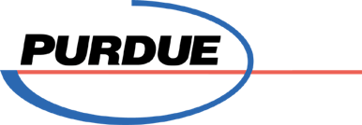
OPIOIDS
AND
Sackler family pays $4.5 billion, states continue to pursue
Tentative agreement with state and local governments for $12 billion
Files for bankruptcy
Restructures into public benefit trust
12TH ANNUAL YEAR-IN-REVIEW 2019
POTOMACRIVERPARTNERS.COM

Slide 44
OPIOIDS
Pays $1.4 billion settlement
Sets aside $4 billion
Sets aside $646 million
12TH ANNUAL YEAR-IN-REVIEW 2019
POTOMACRIVERPARTNERS.COM

Slide 45
OPIOIDS
: STATE SETTLEMENTS
J&J to pay $20 million
Teva to pay $20 million cash and $25 million in treatment
Endo to pay $10 million
Allergan to pay $5 million
in Ohio:
in
Oklahoma:
Teva to pay $85 million
J&J ordered to pay $572 million; plans to appeal
12TH ANNUAL YEAR-IN-REVIEW 2019
POTOMACRIVERPARTNERS.COM

Slide 46
OPIOIDS
STATE SETTLEMENTS
Distributors also feel effects of the opioid backlash…
McKesson:
$37 million to West Virginia
AmerisourceBergen, Cardinal Health, and McKesson:
$215 million to two Ohio counties
Propose $10 billion to settle states’ claims
12TH ANNUAL YEAR-IN-REVIEW 2019
POTOMACRIVERPARTNERS.COM

Slide 47
OPIOIDS
FDA targets opioids
Issues guidance on drug labeling
Launches “Remove the Risk” program
Global actions
China tightens regulations on oxycodone
UK’s NICE announces drug dependence guidelines
Doctors held responsible
Indicted and sentenced in several states
Academics weigh in
Report shows doctors over-prescribed fentanyl
JAMA links opioid epidemic to doctor marketing
12TH ANNUAL YEAR-IN-REVIEW 2019
POTOMACRIVERPARTNERS.COM

Slide 48
NEW STATE LAWS
12TH ANNUAL YEAR-IN-REVIEW 2019
POTOMACRIVERPARTNERS.COM

Slide 49
NEW STATE LAWS
Maine passes Comprehensive Prescription Drug Reform Package
ME
CO
New Jersey amends “Gift Ban” law
NJ
Colorado requires manufacturers to list drug price and alternate generic medications
CA
California:
Implements amendments to the California Consumer Privacy Act
Outlaws pay-for-delay agreements
12TH ANNUAL YEAR-IN-REVIEW 2019
POTOMACRIVERPARTNERS.COM

Slide 50
STATE SETTLEMENTS
12TH ANNUAL YEAR-IN-REVIEW 2019
POTOMACRIVERPARTNERS.COM

Slide 51
STATE SETTLEMENTS
Teva:
$135 million to Illinois for inflating Medicaid prices

Slide 52
STATE SETTLEMENTS
Teva:
$135 million to Illinois for inflating Medicaid prices
Teva, Endo, and Teikoku: $70 million to California for delaying generics

Slide 53
STATE SETTLEMENTS
Teva:
$135 million to Illinois for inflating Medicaid prices
Teva, Endo, and Teikoku: $70 million to California for delaying generics
Johnson & Johnson:
$9.9 million to Washington to settle surgical mesh case

Slide 54
DRUG PRICING
Takes center stage at the federal and state levels…
12TH ANNUAL YEAR-IN-REVIEW 2019
POTOMACRIVERPARTNERS.COM

Slide 55
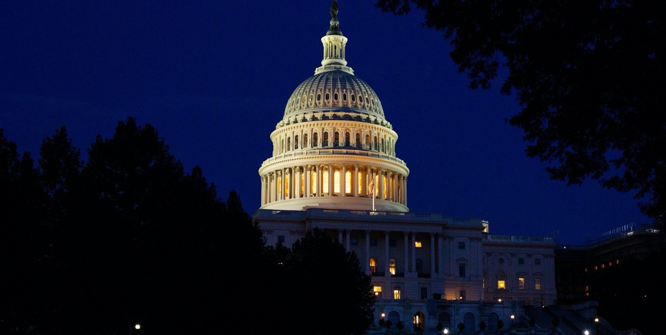
FEDERAL LEVEL
Congress attempts to lower drug prices
Senate Finance Committee releases bill to restructure Part D payment methodologies
House votes for Speaker Pelosi’s drug pricing bill
House releases report comparing US drug prices to other countries
Senators Booker and Sanders propose new federal agency to set drug prices
House Democrats launch drug-pricing probe
Four pharma CEOs testify at Senate drug pricing hearing
12TH ANNUAL YEAR-IN-REVIEW 2019
POTOMACRIVERPARTNERS.COM

Slide 56
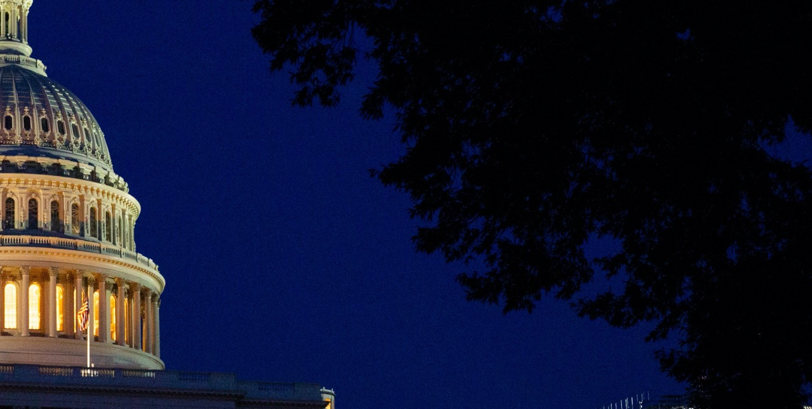
FEDERAL LEVEL
President Trump also prioritizes drug pricing
Executive order to overhaul kidney disease payments
Executive order to expand private Medicare plans
Proposes importation of cheaper drugs
Attempts to require price disclosure in drug ads
Strikes down HHS proposal banning rebates
Signs Medicaid law increasing penalties for drug misclassifications
12TH ANNUAL YEAR-IN-REVIEW 2019
POTOMACRIVERPARTNERS.COM

Slide 57
STATE LEVEL
Nevada:
Releases Diabetes Drug Transparency Report
Fines companies that failed to report
Includes asthma drugs in transparency law
NV
12TH ANNUAL YEAR-IN-REVIEW 2019
POTOMACRIVERPARTNERS.COM

Slide 58
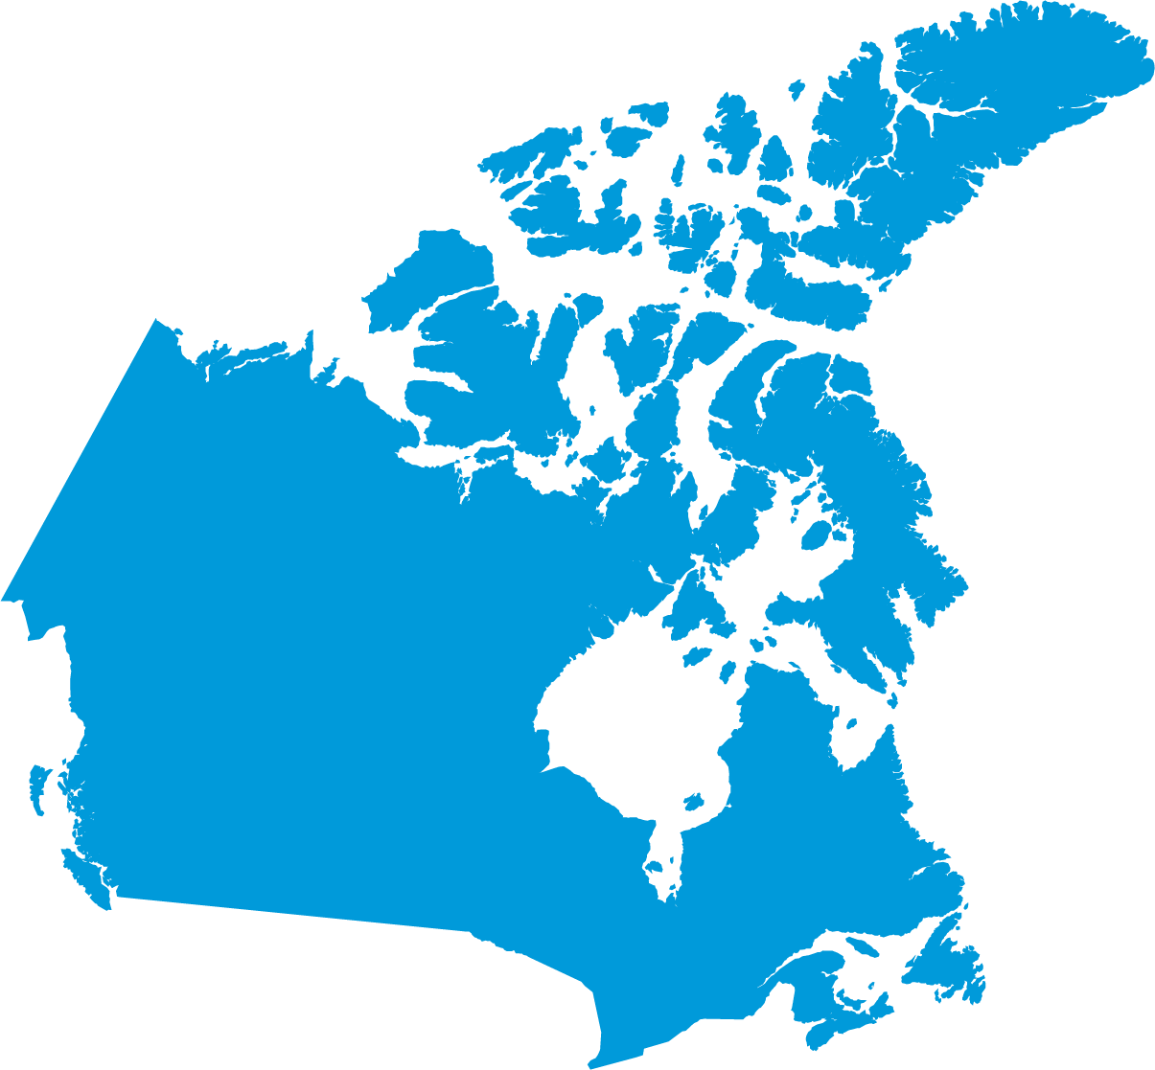
INTERNATIONAL LEVEL
Internationally:
Canada review board launches reforms to set maximum drug prices
12TH ANNUAL YEAR-IN-REVIEW 2019
POTOMACRIVERPARTNERS.COM

Slide 59
INTERNATIONAL LEVEL
Internationally:
Ten European countries band together to lower drug prices
12TH ANNUAL YEAR-IN-REVIEW 2019
POTOMACRIVERPARTNERS.COM

Slide 60
COMPLIANCE NEWS
12TH ANNUAL YEAR-IN-REVIEW 2019
POTOMACRIVERPARTNERS.COM

Slide 61
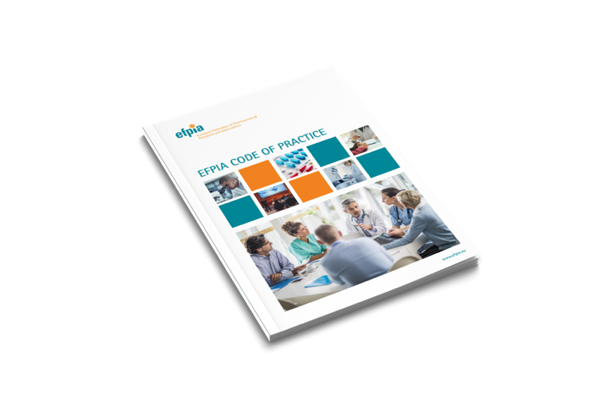
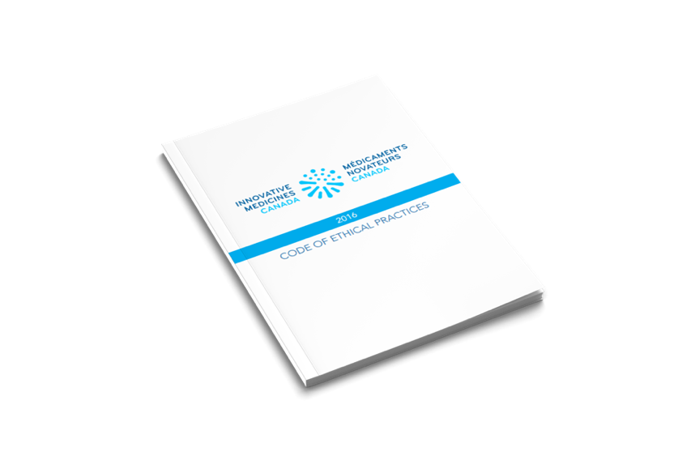
CODE UPDATES
A few key industry groups updated their codes of practice.
AdvaMed
Code of Ethics
PhRMA Code on Interactions with HCPs
EFPIA Code of Practice
(consolidates 3 prior Codes)
Innovative Medicines Canada Code of Ethical Practices
12TH ANNUAL YEAR-IN-REVIEW 2019
POTOMACRIVERPARTNERS.COM

Slide 62
IMDRF:
Bans all gifts by pharma companies
Offers new guidance on cybersecurity
12TH ANNUAL YEAR-IN-REVIEW 2019
POTOMACRIVERPARTNERS.COM

Slide 63
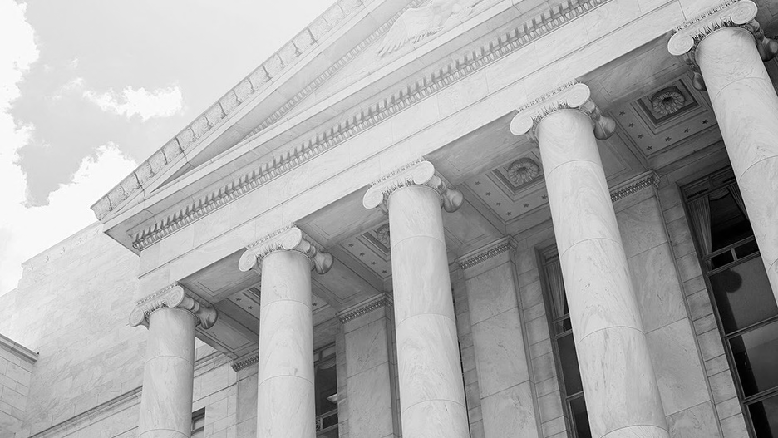
Johnson & Johnson becomes first to include prices in TV ads
District Court allows off-label marketing claims against Aegerion executives
Federal Government chooses not to enforce HHS Policy to limit use of co-pay accumulators
ProPublica review of Open Payments finds 700+ doctors received more than $1 million
DOJ:
Publishes new guidance on evaluating corporate compliance programs
Updates Foreign Corrupt Practices Act Corporate Enforcement Policy
Issues new guidance regarding cooperation in FCA investigations
OIG publishes report on “reasonable assumptions” in price reporting
CMS: Updates Open Payments Program, adding payment reporting categories
12TH ANNUAL YEAR-IN-REVIEW 2019
POTOMACRIVERPARTNERS.COM

Slide 64
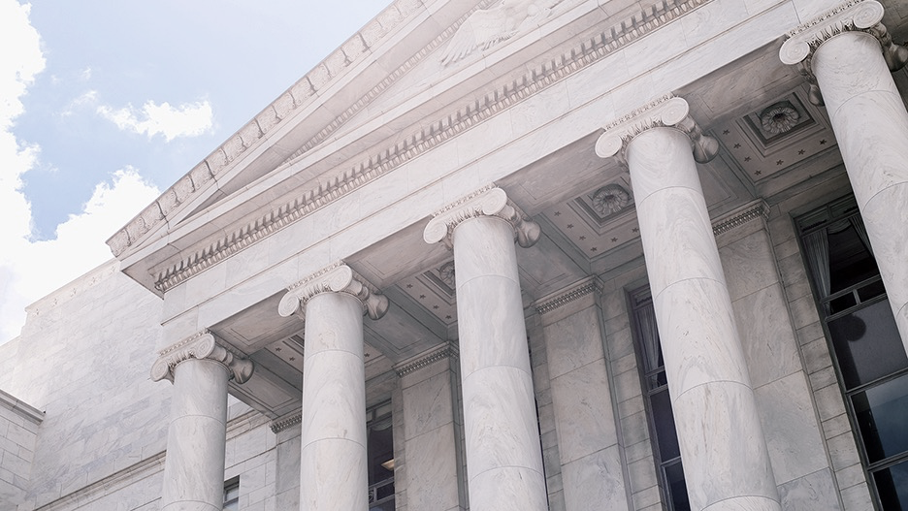
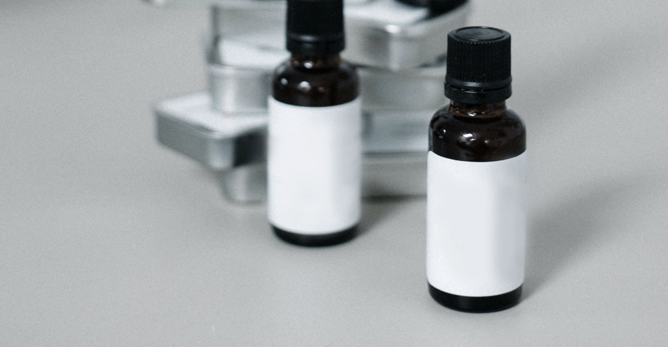
Discloses data integrity issue after approval of “world’s most expensive drug,” Zolgensma
Replaces top scientists that authorized manipulation
FDA issues Form 483; leaves drug on the market
12TH ANNUAL YEAR-IN-REVIEW 2019
POTOMACRIVERPARTNERS.COM

Slide 65
INTERNATIONAL COMPLIANCE NEWS
12TH ANNUAL YEAR-IN-REVIEW 2019
POTOMACRIVERPARTNERS.COM

Slide 66
Executives and board members to repay $50 million for 2016 foreign bribery settlement
12TH ANNUAL YEAR-IN-REVIEW 2019
POTOMACRIVERPARTNERS.COM

Slide 67
Health Canada:
Issues draft guidance on promotional vs. non-promotional messages and activities
Issues guidance on off-label uses of drugs in trials
12TH ANNUAL YEAR-IN-REVIEW 2019
POTOMACRIVERPARTNERS.COM

Slide 68
British PM Johnson announces a UK Medicines and Medical Devices Bill
EU updates rules on financial penalties for pharmaceutical companies
Aspen Pharma agrees to pay ~$10 million to settle UK anti-competition probe
12TH ANNUAL YEAR-IN-REVIEW 2019
POTOMACRIVERPARTNERS.COM

Slide 69
China:
Creates ethics committee to oversee clinical trials
Punishes 48 officials in vaccine scandal
12TH ANNUAL YEAR-IN-REVIEW 2019
POTOMACRIVERPARTNERS.COM

Slide 70
DOJ and FBI cooperate with Brazilian prosecutors to investigate kickbacks
12TH ANNUAL YEAR-IN-REVIEW 2019
POTOMACRIVERPARTNERS.COM

Slide 71
GOOD NEWS
48 new drugs approved in the US alone!
12TH ANNUAL YEAR-IN-REVIEW 2019
POTOMACRIVERPARTNERS.COM

Slide 72
First Ebola vaccine approved in Europe and US
12TH ANNUAL YEAR-IN-REVIEW 2019
POTOMACRIVERPARTNERS.COM

Slide 73
First drug for the treatment of Spinal Muscular Atrophy
12TH ANNUAL YEAR-IN-REVIEW 2019
POTOMACRIVERPARTNERS.COM

Slide 74
First drug targeting root cause of Sickle Cell Disease
12TH ANNUAL YEAR-IN-REVIEW 2019
POTOMACRIVERPARTNERS.COM

Slide 75
New cancer drugs for:
Breast cancer
Bladder cancer
Mantle cell lymphoma
B-cell lymphoma
Multiple myeloma
Tenosynovial giant cell tumors
Prostate cancer
12TH ANNUAL YEAR-IN-REVIEW 2019
POTOMACRIVERPARTNERS.COM

Slide 76
JANUARY 2020 UPDATES
$300 million to settle Loestrin and Minastrin pay-for-delay case
$3 million to settle co-pay allegations (Foundation)
OIG Advisory Opinion on patient expenses
12TH ANNUAL YEAR-IN-REVIEW 2019
POTOMACRIVERPARTNERS.COM

Slide 77
FEDERAL SETTLEMENTS
CIVIL LITIGATION
https://www.justice.gov/opa/pr/three-pharmaceutical-companies-agree-pay-total-over-122-million-resolve-allegations-they-paid
https://www.newsmax.com/finance/streettalk/bayer-j-j-xarelto-lawsuits/2019/03/25/id/908605/
https://www.policymed.com/2019/11/allergan-subsidiary-forest-settles-for-750-million-in-namenda-class-action-pay-for-delay-suit.html?utm_source=feedblitz&utm_medium=FeedBlitzRss&utm_campaign=policymed
https://www.justice.gov/opa/pr/two-pharmaceutical-companies-agree-pay-total-nearly-125-million-resolve-allegations-they-paid
https://www.justice.gov/opa/pr/pharmaceutical-company-agrees-pay-175-million-resolve-allegations-kickbacks-medicare-patients
https://www.reuters.com/article/health-celgene/celgene-settles-antitrust-lawsuit-over-cancer-drugs-for-55-million-idUSL2N24P23Q
https://www.justice.gov/opa/pr/drug-maker-mallinckrodt-agrees-pay-over-15-million-resolve-alleged-false-claims-act-liability
https://www.reuters.com/article/health-mylan/celgene-to-pay-mylan-62-million-to-resolve-cancer-drug-antitrust-case-idUSL2N24V1IQ
https://www.justice.gov/usao-ma/pr/foundations-resolve-allegations-enabling-pharmaceutical-companies-pay-kickbacks-medicare
https://www.pmlive.com/pharma_news/sanofi_settles_lemtrada_dispute_with_genzyme_investors_for_$315m_1315185
https://www.justice.gov/usao-ma/pr/third-foundation-resolves-allegations-it-conspired-pharmaceutical-companies-pay-kickbacks
https://www.chicagotribune.com/business/ct-biz-akorn-investors-sec-settlment-20190731-craqe57exraqpbmys65xegsboa-story.html
https://www.justice.gov/opa/pr/pharmaceutical-company-targeting-elderly-victims-admits-paying-kickbacks-resolves-related
https://www.justice.gov/opa/pr/pharmaceutical-company-agrees-pay-175-million-resolve-allegations-kickbacks-medicare-patients
https://www.reuters.com/article/us-johnson-johnson-risperdal-verdict/jury-says-jj-must-pay-8-billion-in-case-over-male-breast-growth-linked-to-risperdal-idUSKBN1WN2HK
https://www.justice.gov/usao-edpa/pr/pharmaceutical-company-pay-35m-resolve-allegations-paying-kickbacks-doctors
https://www.reuters.com/article/us-johnson-johnson-settlement/jj-agrees-to-pay-about-1-billion-to-resolve-hip-implant-lawsuits-bloomberg-idUSKCN1SD1YO
https://www.justice.gov/opa/pr/fresenius-medical-care-agrees-pay-231-million-criminal-penalties-and-disgorgement-resolve
https://www.justice.gov/usao-edpa/pr/heritage-pharmaceuticals-pays-over-7-million-resolve-civil-false-claims-act-allegations
https://www.justice.gov/opa/pr/medical-device-maker-acell-inc-pleads-guilty-and-will-pay-15-million-resolve-criminal-charges
https://www.justice.gov/usao-sdny/pr/manhattan-us-attorney-settles-civil-fraud-claims-against-medical-device-distributor
https://www.sec.gov/news/press-release/2019-194
https://www.justice.gov/usao-sdny/pr/manhattan-us-attorney-announces-settlement-lawsuit-against-spinal-implant-company-its
https://www.jeffreynewmanlaw.com/blog/durable-medical-equipment-maker-resmed-to-pay-37-5-million-for-paying-kickbacks-to-dme-suppliers-sleep-labs-and-others/
12TH ANNUAL YEAR-IN-REVIEW 2019
POTOMACRIVERPARTNERS.COM
SOURCES

Slide 78
STATE LAW UPDATES
STATE SETTLEMENTS
https://www.maine.gov/governor/mills/news/governor-mills-signs-law-comprehensive-prescription-drug-reform-package-2019-06-24
https://www.reuters.com/article/health-teva/teva-settles-illinois-drug-pricing-lawsuit-for-135-million-idUSL1N1ZC00U
https://www.policymed.com/2019/05/new-jersey-finally-finalizes-its-gift-ban-amendments-exempts-educational-events.html
https://www.cnn.com/2019/07/29/health/drug-companies-delay-generics-california-settlement/index.html
https://www.policymed.com/2019/06/new-colorado-law-to-require-manufacturer-sales-reps-to-provide-prescribers-with-pricing.html
https://www.reuters.com/article/us-johnson-johnson-settlement/jj-u-s-states-settle-hip-implant-claims-for-120-million-idUSKCN1PG26K
https://www.cnbc.com/2019/05/14/california-consumer-privacy-act-could-change-the-internet-in-the-us.html
https://www.usnews.com/news/best-states/washington/articles/2019-04-22/johnson-johnson-settles-washington-pelvic-mesh-lawsuit
https://www.courthousenews.com/california-bars-pay-for-delay-pharmaceutical-industry-practice/
12TH ANNUAL YEAR-IN-REVIEW 2019
POTOMACRIVERPARTNERS.COM
SOURCES

Slide 79
OPIOIDS
https://www.reuters.com/article/us-insys-opioids/founder-execs-of-drug-company-guilty-in-conspiracy-that-fed-opioid-crisis-idUSKCN1S81VB
https://www.cnbc.com/2019/08/20/drugmaker-endo-to-pay-10-million-to-settle-opioid-case-ahead-of-trial.html
https://www.justice.gov/opa/pr/opioid-manufacturer-insys-therapeutics-agrees-enter-225-million-global-resolution-criminal
https://www.cnn.com/2019/05/26/health/drugmaker-teva-to-pay-85-million-to-settle-oklahoma-opioid-lawsuit/index.html
https://www.reuters.com/article/us-insys-opioids-bankruptcy/opioid-manufacturer-insys-files-for-bankruptcy-after-kickback-probe-idUSKCN1TB15Q
https://www.nbcnews.com/news/us-news/johnson-johnson-must-pay-over-572-million-its-role-oklahoma-n1046476
https://www.azag.gov/press-release/ag-brnovich-announces-95-million-settlement-former-vp-sales-insys
https://www.nbcnews.com/news/us-news/west-virginia-settles-opioid-lawsuit-mckesson-37-million-n1001281
https://www.reuters.com/article/us-insys-opioids-new-york/new-york-doctor-convicted-of-taking-kickbacks-from-opioid-maker-insys-idUSKBN1Y92Q3
https://ir.cardinalhealth.com/news/press-release-details/2019/Distributors-Reach-Settlement-With-Ohio-Counties-in-Opioids-Case/default.aspx
https://www.nbcnews.com/news/us-news/purdue-pharma-offers-10-12-billion-settle-opioid-claims-n1046526
https://www.cnbc.com/2019/08/06/opioid-makers-said-to-propose-10-billion-settlement-to-end-state-lawsuits.html
https://www.cnbc.com/2019/09/16/oxycontin-maker-purdue-pharma-files-for-bankruptcy-protection.html
https://www.fda.gov/news-events/press-announcements/statement-steps-make-health-care-professional-and-patient-labeling-information-prescription
https://www.npr.org/2019/09/09/758927743/sacklers-reject-demand-they-surrender-personal-wealth-to-settle-opioid-claims
https://www.cnn.com/2019/03/26/health/purdue-pharma-oklahoma-opioid-lawsuit-settlement-bn/index.html
https://www.fda.gov/news-events/press-announcements/fda-launches-public-education-campaign-encourage-safe-removal-unused-opioid-pain-medicines-homes
https://www.npr.org/2019/07/11/740856948/reckitt-benckiser-agrees-to-pay-1-4-billion-in-opioid-settlement
https://www.reuters.com/article/us-china-drugs-opioid/china-restricts-opioid-in-tighter-painkiller-controls-idUSKCN1UX1GB
https://apnews.com/e1259f92145946ec9457b0a870313d53
http://www.pulsetoday.co.uk/clinical/clinical-specialties/prescribing/nice-announce-prescription-drug-dependence-guidelines-to-cut-deaths/20038396.article
https://news.bloomberglaw.com/pharma-and-life-sciences/teva-braces-for-possible-opioid-cost-with-646-million-provision
https://www.usatoday.com/story/news/nation/2019/02/19/fentanyl-over-prescribed-patients-study-finds-johns-hopkins-fda-painkillers-cancer/2920034002/
https://www.nbcnews.com/health/health-news/johnson-johnson-settles-ohio-counties-20-million-prior-opioid-trial-n1061046
https://www.reuters.com/article/us-health-opioids-drug-companies/study-links-opioid-epidemic-to-painkiller-marketing-idUSKCN1PC1Z6
https://www.cnbc.com/2019/10/21/four-drug-companies-reach-a-settlement-as-opioid-trial-was-set-to-begin.html
12TH ANNUAL YEAR-IN-REVIEW 2019
POTOMACRIVERPARTNERS.COM
SOURCES

Slide 80
FIGHTING PRICE INCREASES
COMPLIANCE NEWS
https://www.finance.senate.gov/chairmans-news/grassley-wyden-release-updated-prescription-drug-pricing-reduction-act-reach-agreement-on-health-extenders
https://www.reuters.com/article/us-johnson-johnson-advertising/jj-becomes-first-drugmaker-to-add-prices-to-television-ads-idUSKCN1PW2WL
https://www.cnn.com/2019/11/15/politics/booker-sanders-drug-prices-proposal/index.html
https://www.jdsupra.com/legalnews/u-s-supreme-court-holds-that-fca-63303/
https://www.nbcnews.com/politics/congress/senate-testimony-pharma-executive-admits-drug-prices-hit-poor-hardest-n976346
https://www.lexology.com/library/detail.aspx?g=6c1d8c19-610c-4366-b748-3d97223a087a
https://www.cnbc.com/2019/12/12/house-passes-speaker-nancy-pelosis-drug-pricing-bill.html
https://www.jdsupra.com/legalnews/blog-oig-report-on-reasonable-13994/
https://waysandmeans.house.gov/media-center/press-releases/ways-and-means-committee-releases-report-international-drug-pricing
https://www.propublica.org/article/we-found-over-700-doctors-who-were-paid-more-than-a-million-dollars-by-drug-and-medical-device-companies
https://www.cnbc.com/2019/01/14/house-democrats-launch-drug-pricing-probe-on-a-dozen-companies.html
https://www.hhs.gov/about/news/2019/10/09/hhs-proposes-stark-law-anti-kickback-statute-reforms.html
https://www.whitehouse.gov/presidential-actions/executive-order-advancing-american-kidney-health/
https://www.akingump.com/en/news-insights/cms-issues-proposed-revisions-to-open-payments-sunshine-act.html
https://www.cnbc.com/2019/10/03/trump-signs-executive-order-he-says-will-improve-medicare-coverage-for-seniors.html
https://www.reuters.com/article/us-usa-healthcare-drugpricing/trump-proposes-rule-for-importing-drugs-from-canada-industry-says-it-wont-cut-costs-idUSKBN1YM1LX
https://www.jdsupra.com/legalnews/doj-updates-fcpa-corporate-enforcement-33465/
https://thehill.com/policy/healthcare/471407-trump-senators-push-for-drug-price-disclosures-despite-setbacks
https://www.policymed.com/2019/05/doj-issues-new-guidance-for-fca-compliance-cooperation-credit.html
https://www.cnbc.com/2019/01/31/cvs-cigna-fall-after-trump-administration-proposes-rule-to-lower-drug-prices.html
https://www.sidley.com/en/insights/newsupdates/2019/05/doj-publishes-new-guidance-on-evaluating-corporate-compliance-programs
https://www.federalregister.gov/documents/2016/10/04/2016-23503/medicare-and-medicaid-programs-reform-of-requirements-for-long-term-care-facilities
https://www.reuters.com/article/us-novartis-avexis/novartis-blames-former-avexis-executives-for-zolgensma-data-manipulation-idUSKBN1W922Q
https://www.policymed.com/2019/06/nevada-releases-diabetes-drug-transparency-report-and-passes-sb262-adding-asthma-drugs-to-the-report.html
https://www.justice.gov/criminal-fraud/page/file/937501/download
https://www.reuters.com/article/us-canada-pharmaceuticals-regulation-fac/factbox-details-of-canadas-biggest-drug-pricing-overhaul-in-decades-idUSKCN1UZ22N
https://www.justice.gov/criminal-fraud/file/838416/download
https://www.europeanpharmaceuticalreview.com/news/103915/ten-european-countries-enter-initiative-to-lower-drug-prices/
https://www.advamed.org/issues/code-ethics/code-ethics
https://www.phrma.org/en/Codes-and-guidelines/Code-on-Interactions-with-Health-Care-Professionals
https://www.efpia.eu/relationships-code/the-efpia-code/
http://innovativemedicines.ca/wp-content/uploads/2015/06/IMC_Code_EN_Annotated.pdf
12TH ANNUAL YEAR-IN-REVIEW 2019
POTOMACRIVERPARTNERS.COM
SOURCES

Slide 81
INTERNATIONAL COMPLIANCE NEWS
GOOD NEWS
https://www.reuters.com/article/us-canada-pharmaceuticals/canada-enacts-drug-price-crackdown-in-blow-to-pharmaceutical-industry-idUSKCN1UZ0XH
https://www.scientificamerican.com/article/ebola-vaccine-approved-in-europe-in-landmark-moment/
https://abcnews.go.com/Health/fda-approves-1st-ebola-vaccine-us/story?id=67845280
http://www.israelnationalnews.com/News/News.aspx/266519
https://www.policymed.com/2019/03/health-canada-begins-to-release-clinical-data-on-drugs-and-devices.html
https://www.novartis.com/news/media-releases/avexis-receives-fda-approval-zolgensma-first-and-only-gene-therapy-pediatric-patients-spinal-muscular-atrophy-sma
https://www.centerwatch.com/articles/12314-health-canada-issues-guidance-on-off-label-uses-of-drugs-in-trials
https://www.fda.gov/drugs/new-drugs-fda-cders-new-molecular-entities-and-new-therapeutic-biological-products/new-drug-therapy-approvals-2019
https://www.independent.co.uk/news/health/brexit-drugs-nhs-medicine-boris-johnson-eu-queens-speech-a9253751.html
https://www.statnews.com/2019/03/05/china-creating-national-medical-ethics-committee/
JANUARY UPDATES
https://www.reuters.com/article/us-cma-aspen-pharmacare/south-africas-aspen-to-pay-8-million-pounds-to-nhs-after-uk-probe-idUSKCN1V40K9
https://www.reuters.com/article/allergan-inks-300-mln-deal-to-end-pay-fo/allergan-inks-300-mln-deal-to-end-pay-for-delay-class-action-in-ri-federal-court-idUSL1N29D0I7
https://time.com/5370052/china-vaccine-scandal-officials-fired/
https://www.justice.gov/opa/pr/patient-services-inc-agrees-pay-3-million-allegedly-serving-conduit-pharmaceutical-companies
https://www.cov.com/media/files/corporate/publications/2019/01/the_new_eu_rules_on_financial_penalties_for_pharma_companies.pdf
https://www.prnewswire.com/news-releases/teva-pharmaceuticals-agrees-to-pay-54-million-to-settle-shepherd-finkelman-miller--shah-llp-false-claims-act-qui-tam-case-300981936.html
https://oig.hhs.gov/fraud/docs/advisoryopinions/2020/AdvOpn20-02.pdf
http://www.imdrf.org/docs/imdrf/final/consultations/imdrf-cons-rrar-cabc-mdrr.pdf
https://www.raps.org/news-and-articles/news-articles/2019/10/imdrf-offers-new-guidance-on-cybersecurity
https://www.reuters.com/article/us-brazil-corruption-healthcare-exclusiv/exclusive-fbi-targets-johnson-johnson-siemens-ge-philips-in-brazil-graft-case-sources-idUSKCN1SN0ZZ
12TH ANNUAL YEAR-IN-REVIEW 2019
POTOMACRIVERPARTNERS.COM
SOURCES

Slide 82
For more information:
ContactUs@potomacriverpartners.com
www.PotomacRiverPartners.com
12TH ANNUAL YEAR-IN-REVIEW 2019
POTOMACRIVERPARTNERS.COM

