Slide 1
Year-in-Review 2013
A summary of events that shaped Compliance
Click to Start
JANUARY 2014

Slide 2
Know the GLOBAL compliance landscape,
so decisions can be made LOCALLY

Slide 3
In China…
China prosecutes pharmaceutical companies and employees
For allegations of bribes and kickbacks to physicians

Slide 4
In France…
France issues final decree on Bertrand Law (French Sunshine)
Adopts retroactive reporting requirement to January 1, 2012

Slide 5
In the U.S.…
CMS releases Sunshine Act Final Rule and launches Open Payments
Tracking of Sunshine payments began
August 1, 2013

Slide 6
GSK announced…
Changes to their global sales and marketing practices
Ending individual sales targets and payments to physicians for speaking engagements

Slide 7
Settlements with U.S. federal government have fallen since record year of 2012:
2012: $6.4 billion
2013: $3.4 billion
versus

Slide 8
Federal Settlements (JAN-JUL)
2013
JANUARY
FEBRUARY
$45 million to resolve Megace® ES
off-label marketing allegations
MARCH
MARCH
APRIL
MAY
JUNE
JULY

Slide 9
Federal Settlements (JAN-JUL)
2013
JANUARY
FEBRUARY
MARCH
$24.9 million to resolve kickback allegations
APRIL
APRIL
MAY
JUNE
JULY

Slide 10
Federal Settlements (JAN-JUL)
2013
JANUARY
FEBRUARY
MARCH
APRIL
MAY
$33.5 million to resolve allegations of
Anti-Kickback Statute and False Claims Act violations
MAY
JUNE
JULY

Slide 11
Federal Settlements (JAN-JUL)
2013
JANUARY
FEBRUARY
MARCH
APRIL
$48.3 million to resolve
False Claims Act allegations
MAY
MAY
JUNE
JULY

Slide 12
Federal Settlements (JAN-JUL)
2013
JANUARY
FEBRUARY
MARCH
APRIL
$500 million to resolve False Claims Act allegations, cGMP violations, and providing false statements to the FDA
MAY
MAY
JUNE
JULY

Slide 13
Federal Settlements (JAN-JUL)
2013
JANUARY
FEBRUARY
MARCH
APRIL
MAY
JUNE
$490 million to resolve allegations of Wyeth’s off-label marketing of Rapamune®
JULY

Slide 14
Federal Settlements (JAN-JUL)
2013
JANUARY
FEBRUARY
MARCH
APRIL
MAY
JUNE
$15 million to resolve kickback allegations
JULY

Slide 15
Federal Settlements (JAN-JUL)
2013
JANUARY
FEBRUARY
MARCH
APRIL
MAY
JUNE
JULY
$3.5 million to settle False Claims Act allegations

Slide 16
Federal Settlements (AUG-DEC)
2013
AUGUST
SEPTEMBER
$30 million to settle False Claims Act allegations
OCTOBER
NOVEMBER
DECEMBER

Slide 17
Federal Settlements (AUG-DEC)
2013
AUGUST
SEPTEMBER
OCTOBER
NOVEMBER
$2.2 Billion to resolve allegations of off-label marketing and kickbacks to physicians for Risperdal®
DECEMBER

Slide 18
Federal Settlements (AUG-DEC)
2013
AUGUST
SEPTEMBER
OCTOBER
NOVEMBER
$5.47 Million to resolve allegations of kickbacks to physicians
DECEMBER

Slide 19
Federal Settlements Summary
2013
≈ $3.4 billion
JANUARY
FEBRUARY
MARCH
APRIL
MAY
JUNE
JULY
AUGUST
SEPTEMBER
OCTOBER
NOVEMBER
DECEMBER

Slide 20
State Settlements and Updates

Slide 21
State Settlements
JAN
$36 million agreement with Texas over Medicaid fraud allegations
JUL
$229 million settlement with eight states for alleged off-label promotion of Avandia and other products
$61 thousand settlement between Vermont and 25 manufacturers
SEP
$88.4 million settlement with Louisiana and 25 pharmaceutical companies over Medicaid price-rigging allegations
NOV
$15 million settlement with Maryland for alleged violations of the Maryland False Health Claims Act
DEC

Slide 22
State Updates
MINNESOTA
January 2013:
No 2013 disclosure reports required
May 2013:
2014 disclosure
reports will be required for 2015

Slide 23
International News

Slide 24
International Compliance
Trouble in China

Slide 25
International Compliance
(UK) “Excessive hospitality” lands ten pharma firms in hot water
France fines Sanofi 40.6 million Euros for disparaging Plavix generics
EFPIA tells pharmaceutical companies to disclose doctor payments
Brazil ups the ante in fighting corporate corruption with
new anti-bribery act
Japan files criminal complaint against Novartis for Diovan Ads

Slide 26
Sunshine Act Update

Slide 27
Sunshine Act Update
CMS releases Final Rule
for Sunshine Act (FEB)
CMS Launches Open Payments
website (APR)
CMS releases reporting templates
for 2013 (MAY)
CMS announces Open Payments mobile app (JUL)
CMS issues six rounds of FAQs and
holds multiple webinars on Open Payments (MAY-DEC)

Slide 28
ProPublica Update
Dollars for Docs database updated for first time since Sept. 7, 2011
ProPublica Op-Ed:
Top Medicare prescribers rake in speaking fees from drugmakers

Slide 29
The FDA is monitoring all forms of media…
TV
#SocialMedia

Slide 30
Be careful what your CEO says on TV
FDA issues warning letter to Aegerion’s CEO for comments made about the product Juxtapid®…
During an interview on CNBC’s “Fast Money”
Leading to a DOJ subpoena seeking Juxtapid® marketing information

Slide 31
FDA Social Media Warning Letters
Be careful what you “Like”
Unapproved use claims are being monitored
Social Media can be seen by anyone… #StayOnLabel
Oasis Consumer Healthcare issued warning letter for posting unapproved uses for Halo™ Germ Defense on company’s Facebook page and…
Vibrant Life Vitamins issued warning letter for Facebook comments
AMARC Enterprises issued warning letter for a “Like” on Facebook
…Tweets claiming unapproved uses

Slide 32
FDA issues Social Media Guidance
Finally. (JAN 2014)

Slide 33
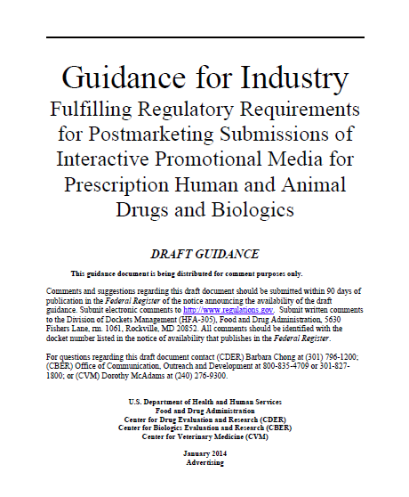
FDA Guidance
Interactive Promotional Media
e.g. blogs, social networking sites, live podcasts, etc.

Slide 34
Individuals are not immune from prosecution…
both in the U.S. and abroad.

Slide 35
Individual Responsibility
U.S. ALLEGATIONS
Former InterMune CEO’s wire fraud conviction upheld
Former Bristol-Myers Squibb executive pleads guilty to insider trading charges
Former Sanofi Rep excluded from doing business with federal healthcare programs for 5 years
U.S. NEWS
Six companies agree to make it easier to recover executive payouts in cases of compliance violations

Slide 36
Individual Responsibility
INTERNATIONAL NEWS
British researcher convicted of manipulating data in pre-clinical trials for Aptuit sentenced to three months in jail
Janssen Korea CEO faces legal action
Four Chinese GSK executives detained over allegations of bribery

Slide 37
Regulations continue to grow…

Slide 38
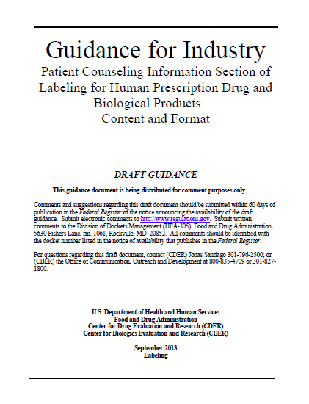
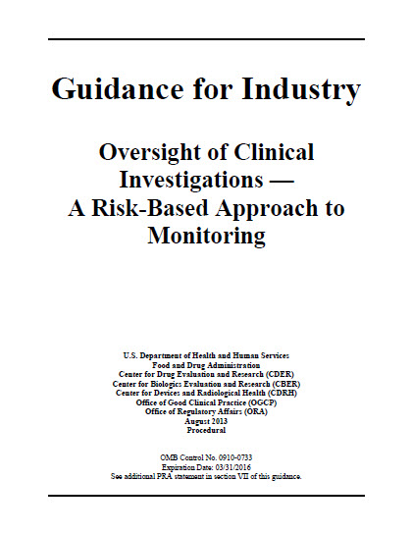
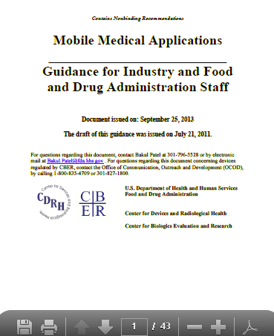
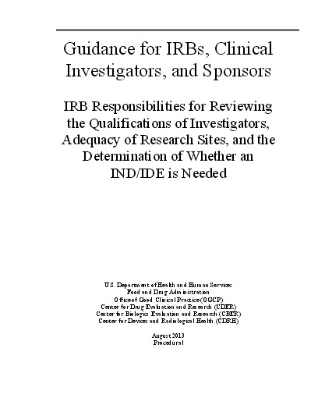
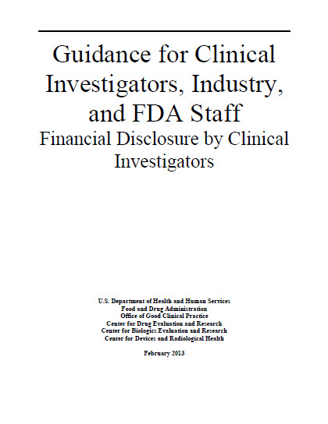
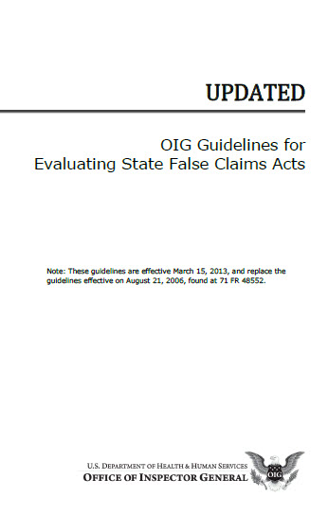
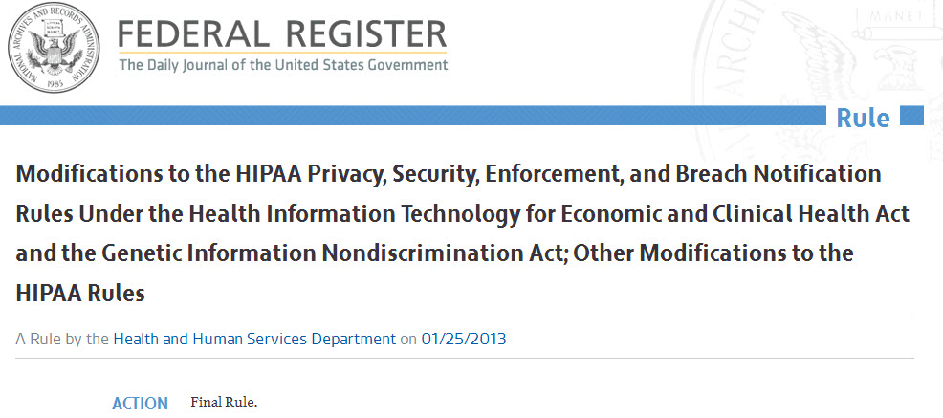
New Federal Guidance and Enforcement
FDA FINAL RULE
Current GMP Requirements
for Combination Products
OIG UPDATE
Guidelines for Evaluating State False Claims Acts
HHS FINAL RULE
Modifications to the HIPAA Rules
FDA GUIDANCE
Financial Disclosure by Clinical Investigators
FDA Final Rule
Governing the Development of
Mobile Medical Applications
FDA Guidance
Patient Counseling Information Prescription Drug
FDA GUIDANCE
IRB Responsibilities for Reviewing the
Qualifications of Investigators and Sites
FDA FINAL GUIDANCE
Oversight of Clinical Investigations –
A Risk-Based Approach to Monitoring

Slide 39
Additional U.S. Government Announcements
FDA won’t appeal U.S. v. Caronia free speech ruling
FDA’s CDER division proposes Office of Pharmaceutical Quality
FDA given green light to ask doctors about advertising
Supreme Court: “Reverse payment” settlements can face antitrust scrutiny
Supreme Court: Generic manufacturers not liable for adverse events under state law

Slide 40
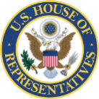
Other Key Compliance News
Duke University study: Violations of PhRMA’s Guiding Principles for DTC Advertising were routine
Trade groups issue consensus principles on industry-physician collaboration
UBC study: Doctors not informed of harmful effects during sales visits
Senator calls for probe into alleged ‘Pay to Delay’ relationship

Slide 41
2014 is shaping up to be a busy year!
BioScrip pays $15 million to resolve kickback allegations; provides information about alleged Novartis kickbacks
Merck fined 15.3 million euros by French competition authority for disparaging Subutex generics
CMS responds to letter from Congress members; medical journals and textbooks not exempt from Open Payments
Supreme Court: Rejects Pfizer’s appeal of ruling for improper marketing of Neurontin® violating RICO and UCL

Slide 42
Ready to keep pace in 2014?

Slide 43
Sources
BREAKING NEWS
STATE SETTLEMENTS
http://www.policymed.com/2013/06/physician-payment-sunshine-france-issues-final-decree-reporting-retroactive-to-january-1-2012.html
https://s3.amazonaws.com/public-inspection.federalregister.gov/2013-02572.pdf
https://www.cms.gov/Regulations-and-Guidance/Legislation/National-Physician-Payment-Transparency-Program/index.html
https://www.cms.gov/Regulations-and-Guidance/Legislation/National-Physician-Payment-Transparency-Program/Downloads/Teaching-Hospital-List-for-2013-Open-Payments-Program-Cycle-20130501-pdf.pdf
http://www.nytimes.com/2013/12/17/business/glaxo-says-it-will-stop-paying-doctors-to-promote-drugs.html?_r=0
https://www.oag.state.tx.us/oagnews/release.php?id=4262
https://www.sec.gov/Archives/edgar/data/1131399/0001191638130009 43/gsk201307246k.htm (see “Legal Matters”), http://www.ag.state.la.us/Article.aspx?articleID=678&catID=0
http://www.atg.state.vt.us/news/attorney-general-settles-with-twenty-five-manufacturers-over-violations-of-vermonts-prescribed-product-gift-ban-and-disclosure-law.php
http://www.ag.state.la.us/Article.aspx?articleID=788&catID=2
http://www.oag.state.md.us/Press/2013/121713a.html
FEDERAL SETTLEMENTS
STATE UPDATES
http://www.justice.gov/opa/pr/2013/March/13-civ-270.html
http://www.justice.gov/opa/pr/2013/April/13-civ-438.htmll
http://www.justice.gov/opa/pr/2013/May/13-civ-606.html
http://www.justice.gov/opa/pr/2013/May/13-civ-547.html
http://www.justice.gov/opa/pr/2013/May/13-civ-542.html
http://www.justice.gov/opa/pr/2013/July/13-civ-860.html
http://www.justice.gov/usao/cac/Pressroom/2013/095.html
http://www.justice.gov/usao/can/news/2013/2013_07_18_mallinckrodt.settled.press.html
http://www.justice.gov/opa/pr/2013/October/13-civ-1107.html
http://www.justice.gov/opa/pr/2013/November/13-ag-1170.html
http://www.justice.gov/opa/pr/2013/December/13-civ-1367.html
http://www.pharmaspective.com/2013/01/the-minnesota-board-of-pharmacy-will-not-require-the-submission-of-annual-disclosure-reports-for-the.html
http://www.policymed.com/2013/06/physician-payment-sunshine-minnesota-officially-scales-back-physician-reporting.html
https://www.revisor.mn.gov/bills/text.php?number=HF1233&version=0&session=ls88&session_year=2013&session_number=0&type=ccr

Slide 44
Sources
NEW REGULATIONS AND GUIDANCE
INDIVIDUAL RESPONSIBILITY
http://www.hhs.gov/news/press/2013pres/01/20130117b.html
http://www.gpo.gov/fdsys/pkg/FR-2013-01-22/html/2013-01068.htm
http://www.fda.gov/downloads/RegulatoryInformation/Guidances/UCM341008.pdf
https://oig.hhs.gov/compliance/self-disclosure-info/files/Provider-Self-Disclosure-Protocol.pdf
https://oig.hhs.gov/fraud/docs/falseclaimsact/guidelines-sfca.pdf
http://www.fda.gov/downloads/Drugs/GuidanceComplianceRegulatoryInformation/Guidances/UCM269919.pdf
http://www.fda.gov/downloads/RegulatoryInformation/Guidances/UCM328855.pdf
http://www.fda.gov/downloads/MedicalDevices/DeviceRegulationandGuidance/GuidanceDocuments/UCM263366.pdf
http://www.fda.gov/downloads/BiologicsBloodVaccines/GuidanceComplianceRegulatoryInformation/Guidances/Vaccines/ucm092257.pdf
http://www.businessweek.com/news/2013-03-05/ex-intermune-ceo-harkonen-s-wire-fraud-conviction-upheld
http://www.pharmalive.com/clawing-back-money-pharma-execs-over-bad-behavior
http://online.wsj.com/news/articles/SB10001424127887323646604578400912618817612
https://www.fbi.gov/newark/press-releases/2013/bristol-myers-squibb-executive-pleads-guilty-to-insider-trading-charges
http://www.pharmalive.com/former-sanofi-rep-excluded-from-healthcare-programs-for-sample-scheme
https://oig.hhs.gov/fraud/enforcement/cmp/kickback.asp
https://theconversation.com/uk-researcher-sentenced-to-three-months-jail-for-faking-data-13619
http://www.koreatimes.co.kr/www/news/nation/2013/05/116_135850.html
http://www.bloomberg.com/news/2013-07-15/glaxo-case-part-of-wider-china-probe-on-drugs-market-daily-says.html
http://www.telegraph.co.uk/finance/newsbysector/pharmaceuticalsandchemicals/10380890/GSKs-Mark-Reilly-barred-from-leaving-China.html
SOCIAL MEDIA
PRO PUBLICA UPDATE
http://www.fda.gov/downloads/Drugs/GuidanceComplianceRegulatoryInformation/EnforcementActivitiesbyFDA/WarningLettersandNoticeofViolationLetterstoPharmaceuticalCompanies/UCM374338.pdf
http://www.reuters.com/article/2014/01/10/us-aegerion-gets-doj-subpeona-over-marke-idUSBREA0901A20140110
http://www.fda.gov/ICECI/EnforcementActions/WarningLetters/2012/ucm340266.htm
http://www.fda.gov/ICECI/EnforcementActions/WarningLetters/2013/ucm339773.htm
http://www.fda.gov/ICECI/EnforcementActions/WarningLetters/2013/ucm364664.htm
http://www.fda.gov/downloads/Drugs/GuidanceComplianceRegulatoryInformation/Guidances/UCM381352.pdf
https://www.propublica.org/series/dollars-for-docs/
https://www.propublica.org/article/top-medicare-prescribers-rake-in-speaking-fees-from-drugmakers
http://papers.ssrn.com/sol3/papers.cfm?abstract_id=2297094

Slide 45
Sources
OTHER KEY COMPLIANCE NEWS
SUNSHINE ACT
http://www.acog.org/~/media/Committee%20Opinions/Committee%20on%20Ethics/co541.pdf?dmc=1&ts=20121025T1645228769.
http://online.wsj.com/article/SB10001424127887324539304578260323575925896.html
http://www.fda.gov/NewsEvents/Speeches/ucm340870.htm
http://jhppl.dukejournals.org/content/early/2013/02/11/03616878-2079496.full.pdf
http://www.hlc.org/blog/wp-content/uploads/2013/03/NDHI-Principles-Statement-Final4.pdf
http://thehill.com/blogs/regwatch/healthcare/294765-fda-given-green-light-to-ask-docs-about-drug-advertising#ixzz2RCE5GpSp
http://www.weirtondailytimes.com/page/content.detail/id/605322/Manchin-wants-FDA--drug-companies-probe.html?nav=5006
http://www.publicaffairs.ubc.ca/2013/04/10/doctors-not-informed-of-harmful-effects-of-medicines-during-sales-visits/
http://www.supremecourt.gov/opinions/12pdf/12-416_m5n0.pdf
http://www.supremecourt.gov/opinions/12pdf/12-142_8njq.pdf
http://www.supremecourt.gov/orders/courtorders/120913zor_o7jq.pdf
http://www.reuters.com/article/2013/12/09/us-usa-court-pfizer-idUSBRE9B80K020131209
http://www.reuters.com/article/2013/12/19/france-fine-idUSL6N0JY2DE20131219
http://www.fdanews.com/articles/161697-lawmakers-pursue-repeal-of-sunshine-reporting-requirement-for-medical-journals?v=preview
http://www.justice.gov/usao/nys/pressreleases/January14/NovartsBioScrip.php
https://s3.amazonaws.com/public-inspection.federalregister.gov/2013-02572.pdf
https://www.cms.gov/Regulations-and-Guidance/Legislation/National-Physician-Payment-Transparency-Program/index.html
http://www.cms.gov/Regulations-and-Guidance/Legislation/PaperworkReductionActof1995/PRA-Listing-Items/CMS-10419.html
http://www.natlawreview.com/article/physician-groups-seek-sunshine-act-changes
http://www.cmanet.org/files/assets/news/2013/10/sunshine-act-sebelius-sign-on-10-23-13.pdf
https://www.cms.gov/Newsroom/MediaReleaseDatabase/Press-Releases/2013-Press-Releases-Items/2013-07-17-2.html
http://www.cms.gov/Regulations-and-Guidance/Legislation/National-Physician-Payment-Transparency-Program/Events.html
https://questions.cms.gov/faq.php
http://www.bloomberg.com/news/2014-01-10/cgi-to-be-replaced-by-accenture-on-obamaacre-contract.html
http://policymed.typepad.com/files/cms-text-books-and-reprints-letter.pdf
http://www.fdanews.com/articles/161697-lawmakers-pursue-repeal-of-sunshine-reporting-requirement-for-medical-journals?v=preview
INTERNATIONAL COMPLIANCE
http://www.pharmatimes.com/Article/13-04-05/Excessive_hospitality_lands_ten_pharma_firms_in_hot_water.aspx
http://www.reuters.com/article/2013/05/14/sanofi-plavix-idUSL6N0DV1J120130514
http://transparency.efpia.eu/the-efpia-code-2
http://www.mondaq.com/unitedstates/x/257934/Compliance/The+FCPA+on+Steroids+Brazil+Ups+the+Ante+in+Fighting+Corporate+Corruption
http://uk.reuters.com/article/2014/01/09/uk-novartis-diovan-japan-idUKBREA0803220140109

Slide 46
Sources
TROUBLE IN CHINA
http://www.channelnewsasia.com/news/business/international/china-police-probe-staff/730392.html?
http://www.nytimes.com/2013/07/26/business/glaxo-replaces-chief-of-china-unit-at-center-of-bribery-inquiry.html?adxnnl=1&adxnnlx=1374858069-ahbv5tTaNlW9Qtc6RawxpA&_r=0
http://www.nytimes.com/2013/07/22/business/global/files-suggest-a-graft-case-in-china-may-expand.html
http://www.nytimes.com/2013/07/23/business/global/drug-research-in-china-falls-under-a-cloud.html?_r=0
http://www.bloomberg.com/news/2013-07-15/four-drugmakers-face-china-probes-as-glaxo-woes-widen.html
http://in.reuters.com/article/2013/07/19/us-gsk-china-ucb-idUSBRE96H0XQ20130719
http://www.reuters.com/article/2013/07/23/gsk-china-idUSL6N0FT1VG20130723
http://www.bloomberg.com/news/2013-08-01/j-j-fined-in-china-as-eli-lilly-sanofi-visited-by-regulators.html
http://www.marketwatch.com/story/baxter-reveals-expense-misconduct-in-china-2013-08-02
http://www.scmp.com/news/china/article/1295285/frances-sanofi-takes-china-bribery-claims-very-seriously
http://www.bloomberg.com/news/2013-08-07/race-to-publish-shows-glaxo-zeal-to-get-leg-up-in-china.html
http://news.xinhuanet.com/english/china/2013-08/10/c_132619339.htm
http://www.shanghaidaily.com/national/Saleswoman-claims-she-was-told-to-bribe-doctors/shdaily.shtml
http://online.wsj.com/article/SB10001424127887323639704579012910236595586.html
http://www.reuters.com/article/2013/10/16/us-gsk-china-idUSBRE99F0BS20131016
http://www.reuters.com/article/2013/08/21/china-briton-arrest-idUSL4N0GH1NH20130821
http://www.reuters.com/article/2013/08/22/elililly-china-bribery-idUSL4N0GN0JW20130822
http://www.reuters.com/article/2013/09/13/us-bayer-china-idUSBRE98C06Y20130913
http://www.bloomberg.com/news/2014-01-15/actavis-to-quit-china-as-trouble-seen-for-little-profit.html

Slide 47
Thank you.
Call us at 703.430.5944,
or visit www.PotomacRiverPartners.com

