Slide 1


2010 Year in Review
A Look Back on the Events that Helped Shape Compliance
Notes:
1

Slide 2
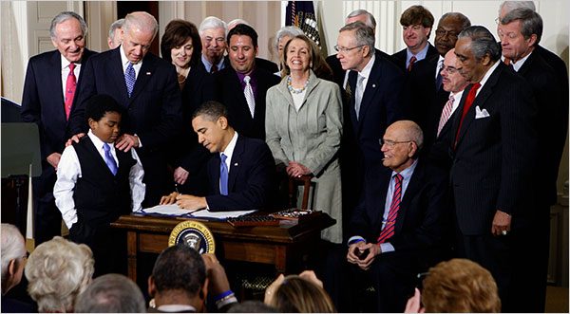
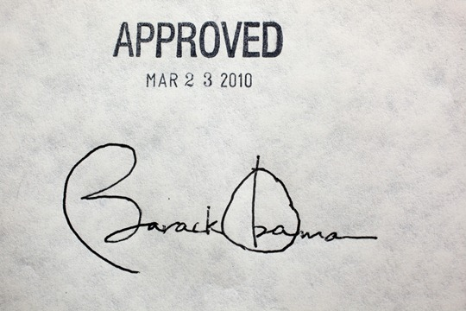

March 23, 2010
History was made...
...with the stroke of 22 pens!
www.potomacriverpartners.com

Slide 3

PPACA
Section 6002 let the sunshine in…
www.potomacriverpartners.com

Slide 4




PPACA
Section 6002 – Spend Disclosure
AND
Doctors
Teaching Hospitals
www.potomacriverpartners.com

Slide 5

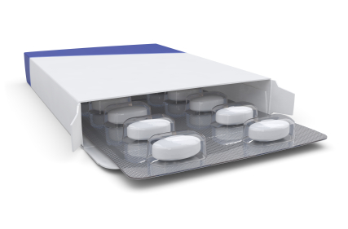
PPACA
Section 6004 – Samples
Prescription drug
sample transparency
www.potomacriverpartners.com

Slide 6


PPACA
Other Provisions
Easier for the government to prove a violation of the Anti-Kickback Statute
Violations of the Anti-Kickback Statute now automatically constitute a False Claims Act violation
www.potomacriverpartners.com

Slide 7


Federal Settlements Continue…
Over $3.9 Billion
in recoveries
www.potomacriverpartners.com

Slide 8

2010 Federal Settlements
Key:
Settlement
Announced settlement
$3.76M
Alleged off-label promotion of surgical ablation devices
JAN FEB MAR APR MAY JUN JUL AUG SEP OCT NOV DEC
www.potomacriverpartners.com

Slide 9

Key:
Settlement
Announced settlement
$1.4M
Alleged off-label promotion of surgical ablation devices
JAN FEB MAR APR MAY JUN JUL AUG SEP OCT NOV DEC
www.potomacriverpartners.com

Slide 10

Key:
Settlement
Announced settlement
Alleged promotion of Seroquel for unapproved uses
$520M
JAN FEB MAR APR MAY JUN JUL AUG SEP OCT NOV DEC
www.potomacriverpartners.com

Slide 11

Key:
Settlement
Announced settlement
Alleged promotion of Topamax for unapproved psychiatric uses
$81M
JAN FEB MAR APR MAY JUN JUL AUG SEP OCT NOV DEC
www.potomacriverpartners.com

Slide 12

Key:
Settlement
Announced settlement
Alleged quality-control problems at manufacturing plant
$175M
JAN FEB MAR APR MAY JUN JUL AUG SEP OCT NOV DEC
www.potomacriverpartners.com

Slide 13

Key:
Settlement
Announced settlement
Alleged false claims submitted for unapproved medications
$22M
JAN FEB MAR APR MAY JUN JUL AUG SEP OCT NOV DEC
www.potomacriverpartners.com

Slide 14

Key:
Settlement
Announced settlement
$72M
Alleged off-label promotion of cystic fibrosis drug TOBI
JAN FEB MAR APR MAY JUN JUL AUG SEP OCT NOV DEC
www.potomacriverpartners.com

Slide 15


Key:
Settlement
Announced settlement
Alleged false claims submitted for unapproved uses of Botox
$600M
JAN FEB MAR APR MAY JUN JUL AUG SEP OCT NOV DEC
www.potomacriverpartners.com

Slide 16

Key:
Settlement
Announced settlement
Alleged distribution of unapproved Levothroid and off-label promotion
$313M
JAN FEB MAR APR MAY JUN JUL AUG SEP OCT NOV DEC
www.potomacriverpartners.com

Slide 17


Key:
Settlement
Announced settlement
Alleged promotion of Trileptal and 5 other drugs for off-label uses
$422.5M
JAN FEB MAR APR MAY JUN JUL AUG SEP OCT NOV DEC
www.potomacriverpartners.com

Slide 18

Key:
Settlement
Announced settlement
Alleged kickbacks to surgeons for use of hip and knee implants
$7.9M
JAN FEB MAR APR MAY JUN JUL AUG SEP OCT NOV DEC
www.potomacriverpartners.com

Slide 19


Key:
Settlement
Announced settlement
Alleged unauthorized use of medical devices in clinical trials
$23.5M*
*Must divest subsidiary Norian
JAN FEB MAR APR MAY JUN JUL AUG SEP OCT NOV DEC
www.potomacriverpartners.com

Slide 20


Key:
Settlement
Announced settlement
Alleged manufacturing and distribution of adulterated drugs at a Puerto Rico plant
$750M
JAN FEB MAR APR MAY JUN JUL AUG SEP OCT NOV DEC
www.potomacriverpartners.com

Slide 21

Key:
Settlement
Announced settlement
$9.2M
Alleged kickbacks to doctors who bought its pacemakers
JAN FEB MAR APR MAY JUN JUL AUG SEP OCT NOV DEC
www.potomacriverpartners.com

Slide 22

Key:
Settlement
Announced settlement
Alleged violations of false claims act through inflated pricing
$280M
JAN FEB MAR APR MAY JUN JUL AUG SEP OCT NOV DEC
www.potomacriverpartners.com

Slide 23


Key:
Settlement
Announced settlement
Alleged violations of false claims act through inflated pricing
$126.5M
JAN FEB MAR APR MAY JUN JUL AUG SEP OCT NOV DEC
www.potomacriverpartners.com

Slide 24


Key:
Settlement
Announced settlement
Alleged violations of false claims act through inflated pricing
$14.7M
JAN FEB MAR APR MAY JUN JUL AUG SEP OCT NOV DEC
www.potomacriverpartners.com
Notes:
http://www.bbraunusa.com/news-2010-12-08.html

Slide 25

Key:
Settlement
Announced settlement
Alleged off-label promotion of cholesterol drugs and kickbacks to physicians
$41M
JAN FEB MAR APR MAY JUN JUL AUG SEP OCT NOV DEC
www.potomacriverpartners.com

Slide 26

Key:
Settlement
Announced settlement
Alleged kickbacks to doctors who used the company’s products
$3M
JAN FEB MAR APR MAY JUN JUL AUG SEP OCT NOV DEC
www.potomacriverpartners.com

Slide 27


Key:
Settlement
Announced settlement
$203M
Alleged off-label marketing of Zonegran
JAN FEB MAR APR MAY JUN JUL AUG SEP OCT NOV DEC
www.potomacriverpartners.com

Slide 28

Key:
Settlement
Announced settlement
Alleged violations of false claims act through inflated pricing
$280M
JAN FEB MAR APR MAY JUN JUL AUG SEP OCT NOV DEC
www.potomacriverpartners.com

Slide 29
The States
Have Been Busy…
www.potomacriverpartners.com

Slide 30

State Settlements of
Medicaid Pricing Allegations
March - $3.6M
MA
March - $3.6M
MA
www.potomacriverpartners.com
Notes:
30

Slide 31

State Settlements of
Medicaid Pricing Allegations
March - $3.6M
MA
April - $7.75M
WI
April - $7.75M
WI
www.potomacriverpartners.com
Notes:
31

Slide 32


State Settlements of
Medicaid Pricing Allegations
March - $3.6M
MA
April - $7.75M
WI
June - $13M
MA
June - $13M
MA
www.potomacriverpartners.com
Notes:
32

Slide 33

State Settlements of
Medicaid Pricing Allegations
March - $3.6M
MA
April - $7.75M
WI
June - $13M
MA
July - $51.4M
TX
July - $51.4M
TX
www.potomacriverpartners.com
Notes:
33

Slide 34

State Settlements of
Medicaid Pricing Allegations
March - $3.6M
MA
April - $7.75M
WI
June - $13M
MA
July - $51.4M
TX
Sept - $21M
MA & MI
Sept - $21M
MA & MI
www.potomacriverpartners.com
Notes:
34

Slide 35




State Settlements of
Medicaid Pricing Allegations
March - $3.6M
MA
April - $7.75M
WI
June - $13M
MA
July - $51.4M
TX
Oct - $82M
HI
Oct - $82M
HI
Sept - $21M
MA & MI
www.potomacriverpartners.com
Notes:
35

Slide 36
State Settlements of
Medicaid Pricing Allegations
March - $3.6M
MA
April - $7.75M
WI
June - $13M
MA
July - $51.4M
TX
Sept - $21M
MA & MI
Oct - $82M
HI
www.potomacriverpartners.com
Notes:
36

Slide 37


State Updates
Massachusetts
Connecticut
Payments to healthcare providers published online
Law requires code of conduct on interactions with HCPs
www.potomacriverpartners.com

Slide 38


State Updates: Data Mining
Maine
Vermont
Upheld in Maine
Overturned in Vermont
What will the U.S. Supreme Court say?
www.potomacriverpartners.com

Slide 39




Individual Responsibility*
2010 Activity on Prior Allegations
Four former executives plead guilty
Former CEO convicted of wire fraud
Three former executives plead guilty to misbranding charges
Physician and former sales rep plead guilty to conspiracy charges to misbrand
Former District Manager found guilty of obstruction of justice
*Company logos are used for illustrative purposes only - individual prosecution does not implicate corporate responsibility

Slide 40





Individual Responsibility*
New Allegations
Alleged obstruction of justice and false statements made by former attorney
Former Chairman of the Board banned from federal healthcare
Former President charged with wire fraud, aiding and abetting, conspiracy and false statements
Two former executives settle for alleged
inflation of profits
Former CEO indicted on 12 counts including
conspiracy to defraud the government
*Company logos are used for illustrative purposes only - individual prosecution does not implicate corporate responsibility

Slide 41

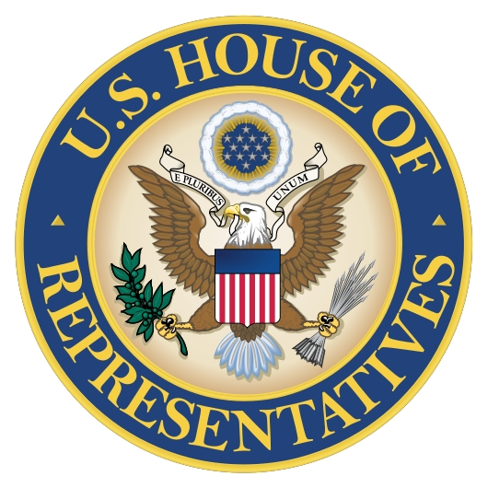
An Update from the Hill…
  Senator Grassley asks HHS to investigate high prescriptions under Medicare and Medicaid
  Senate bill would bolster drug safety requirements
  House bill punishes executives for company fraud
  House passes limits on 'pay-for-delay' settlements
www.potomacriverpartners.com

Slide 42


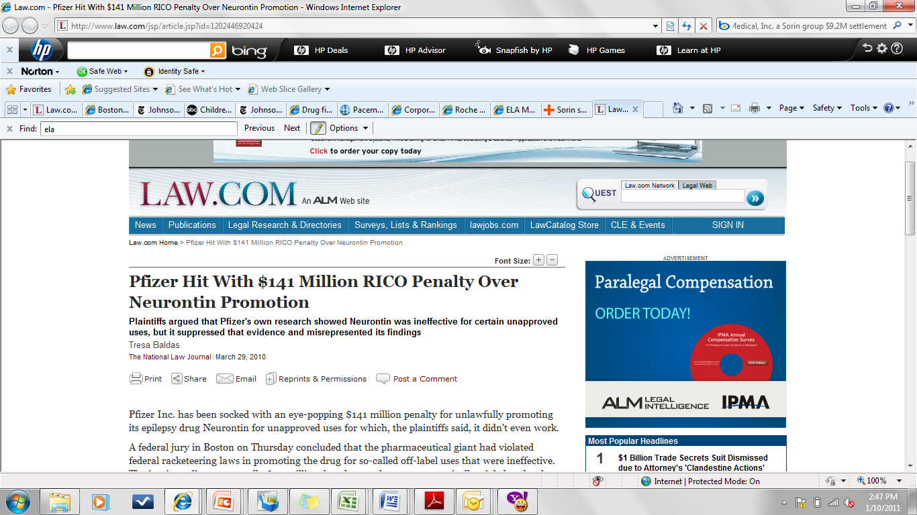
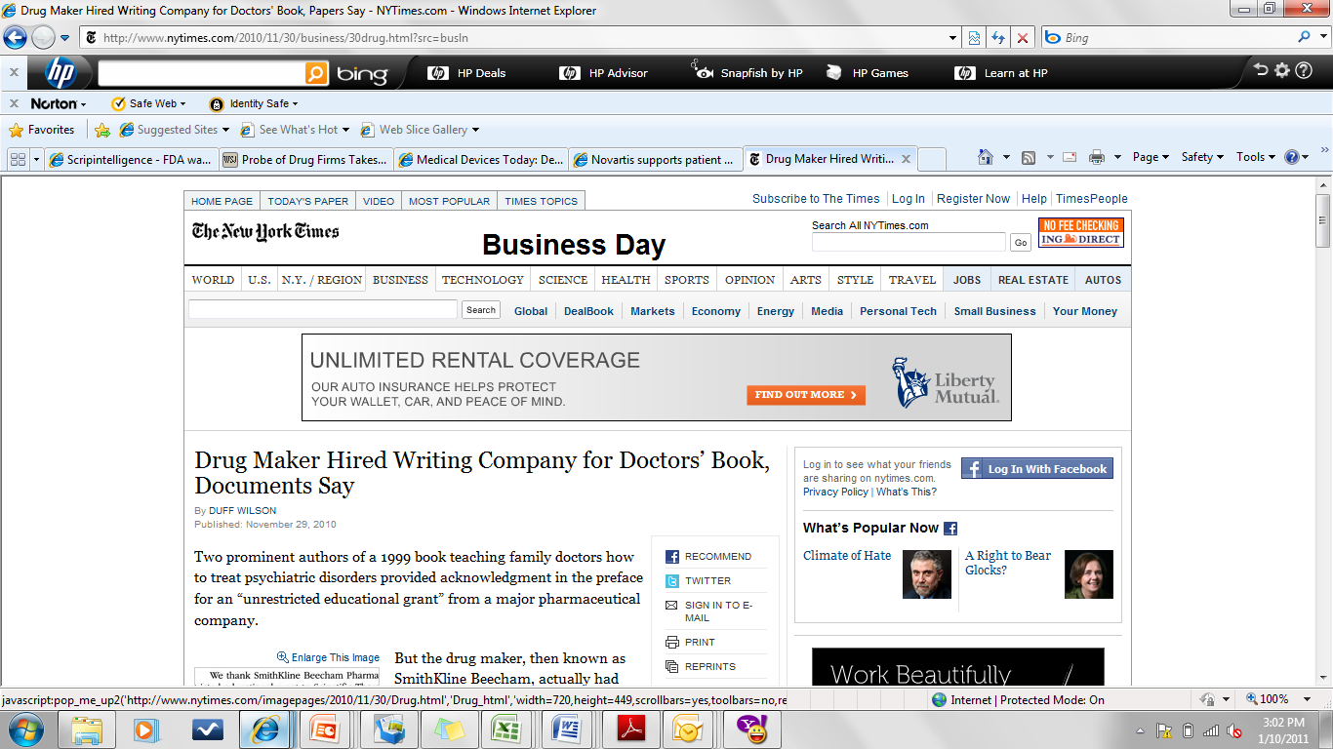
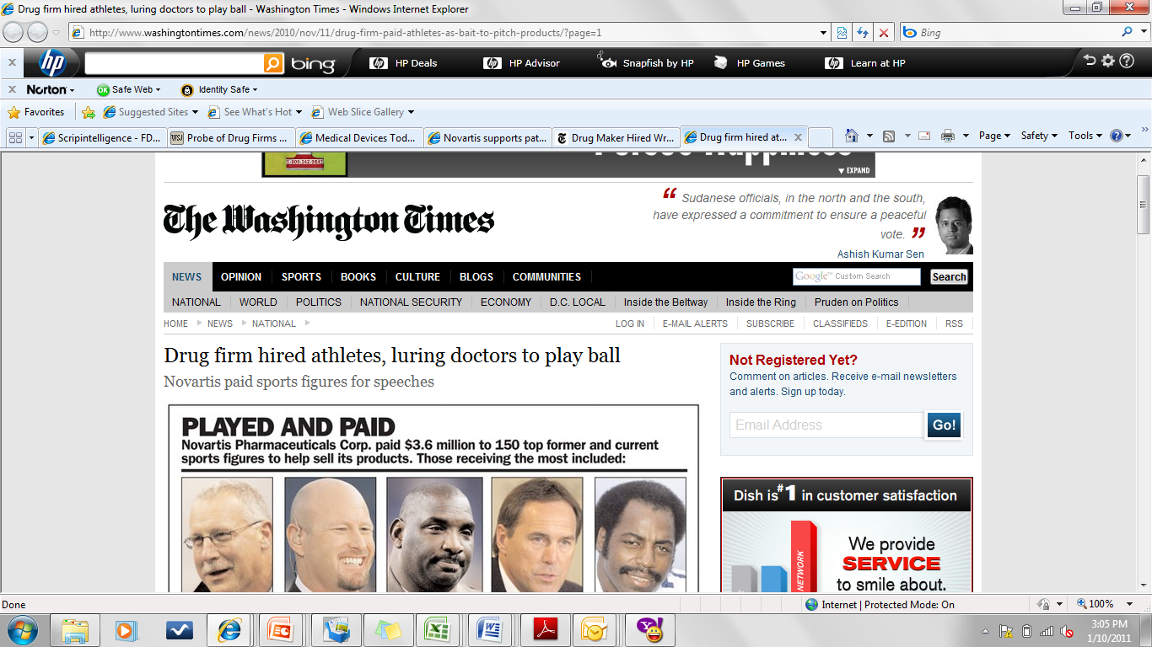

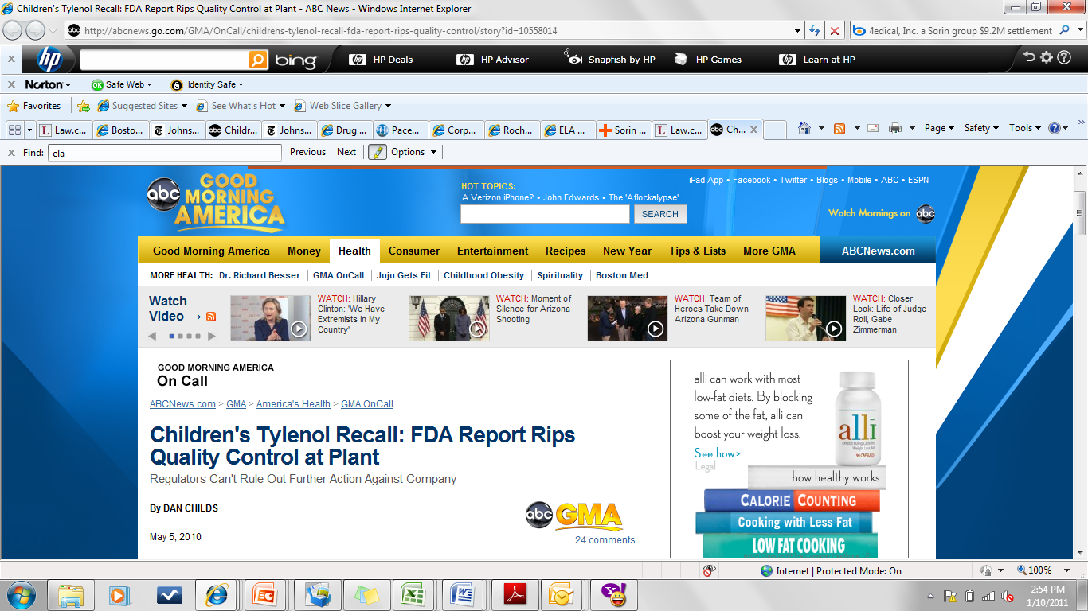
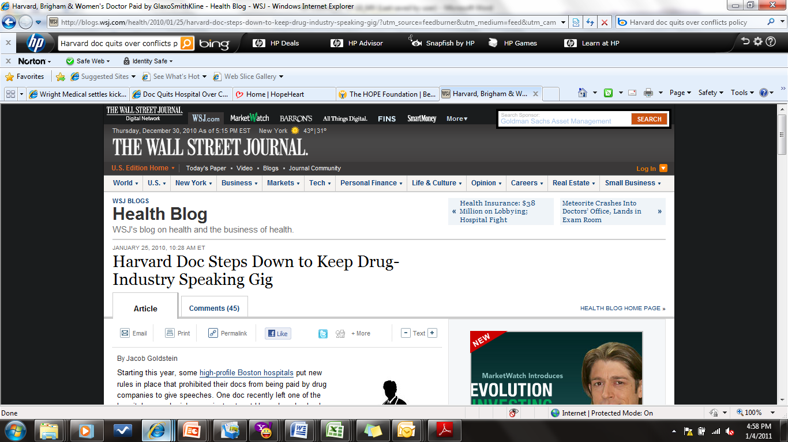
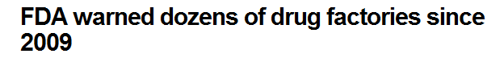
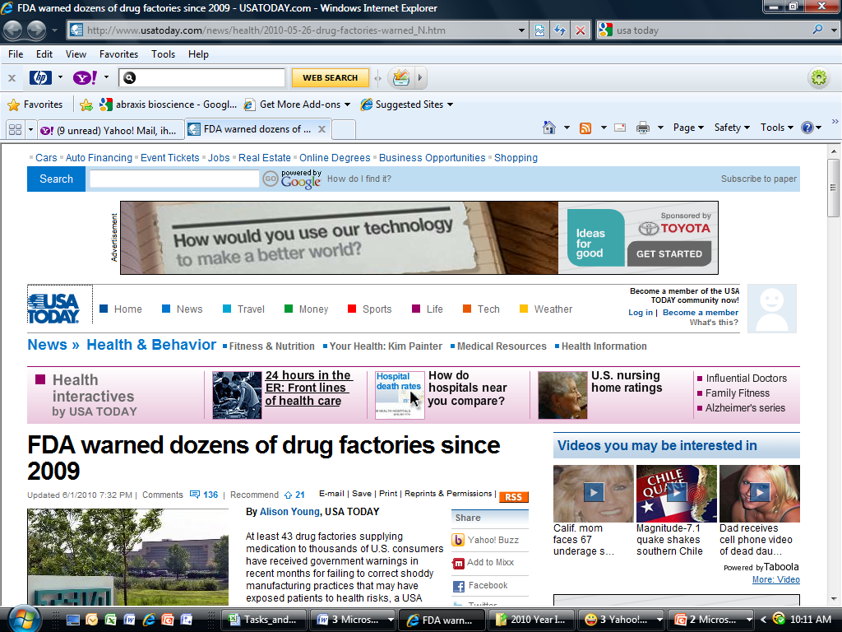
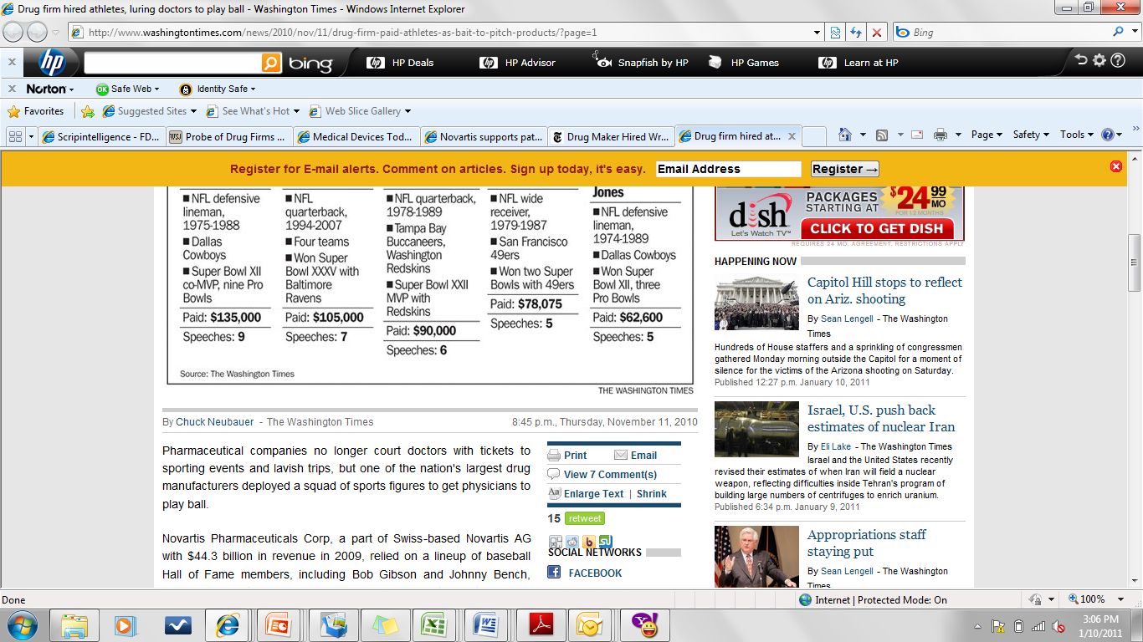
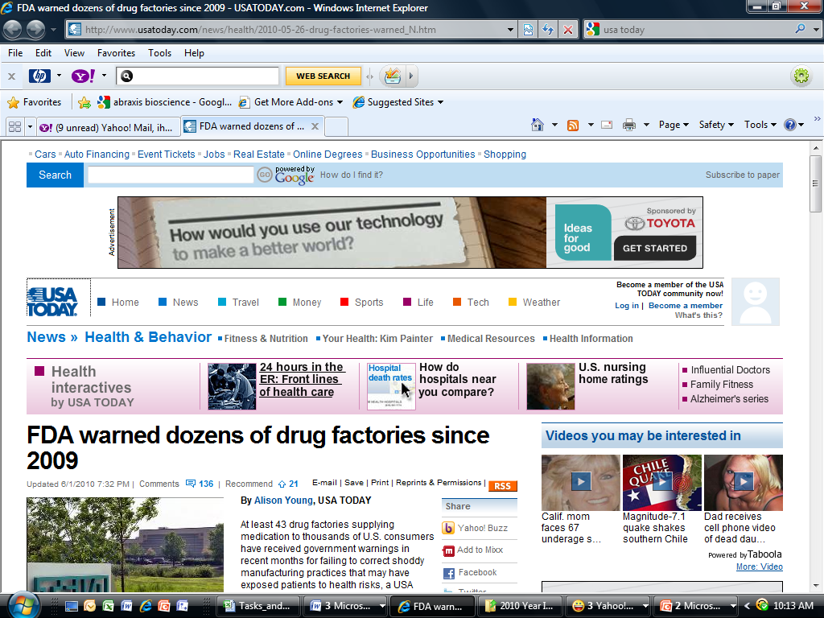

Slide 43
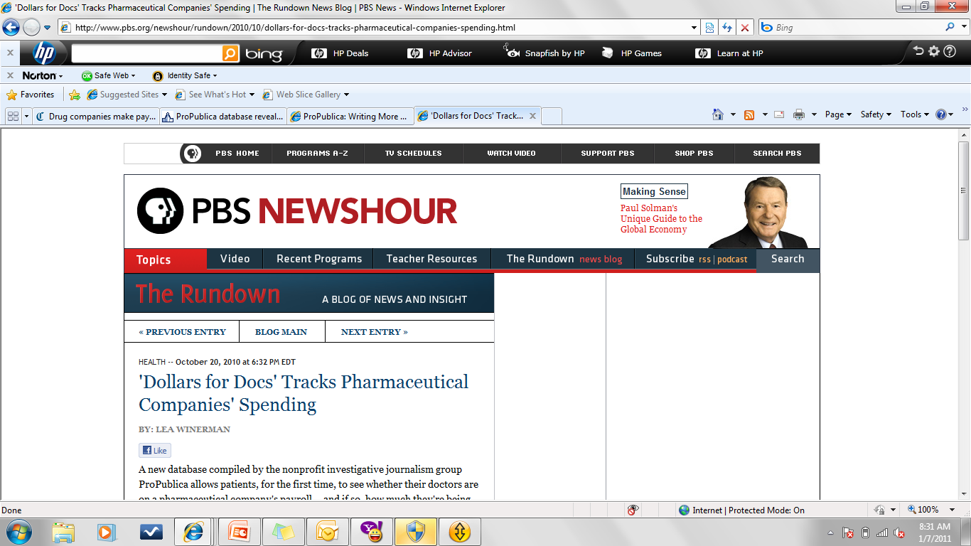
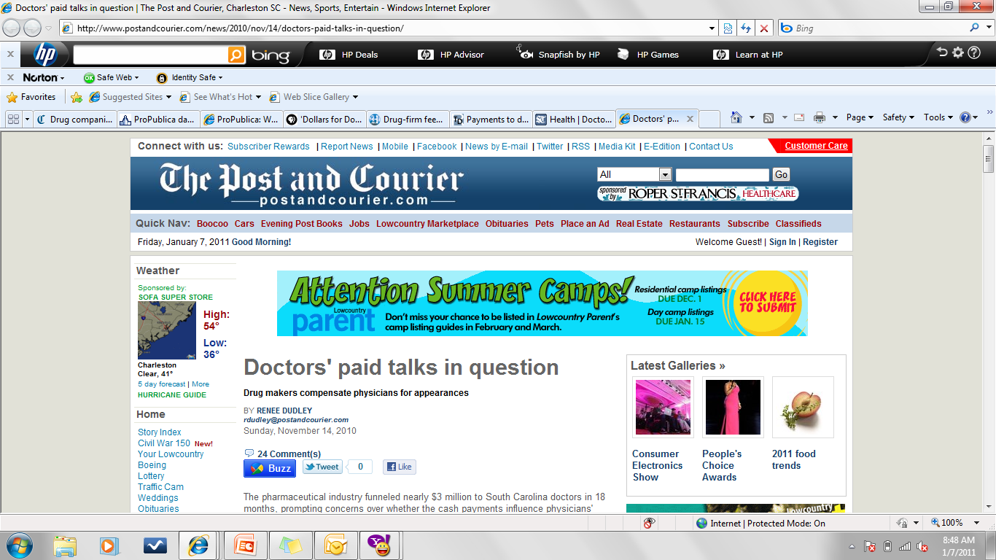
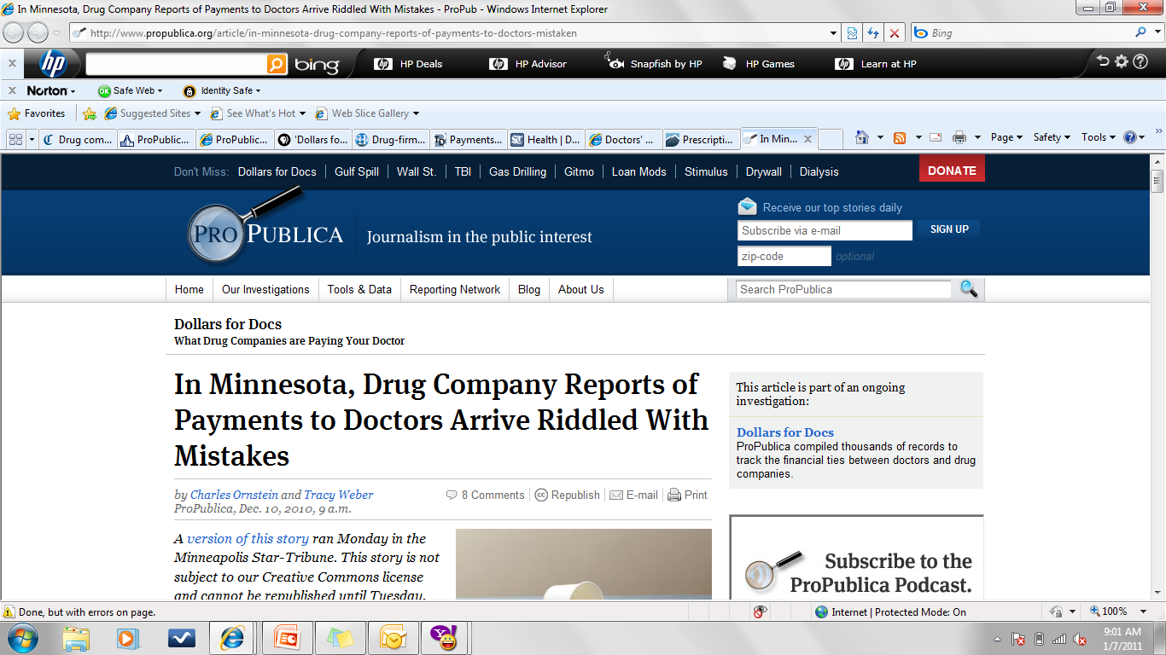
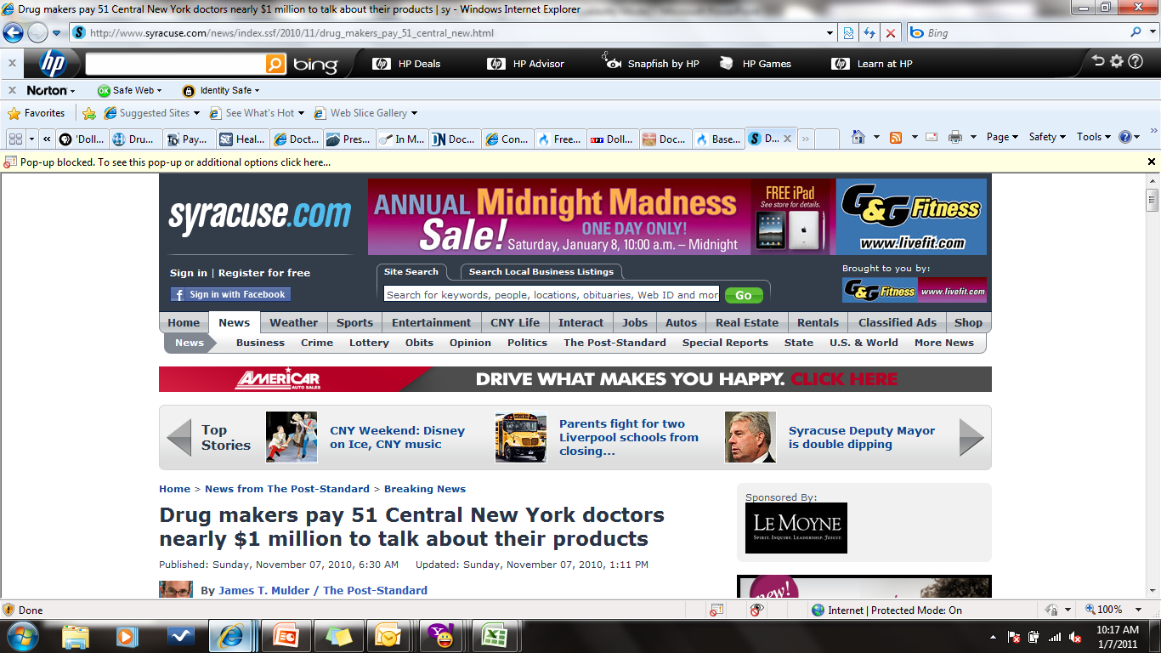


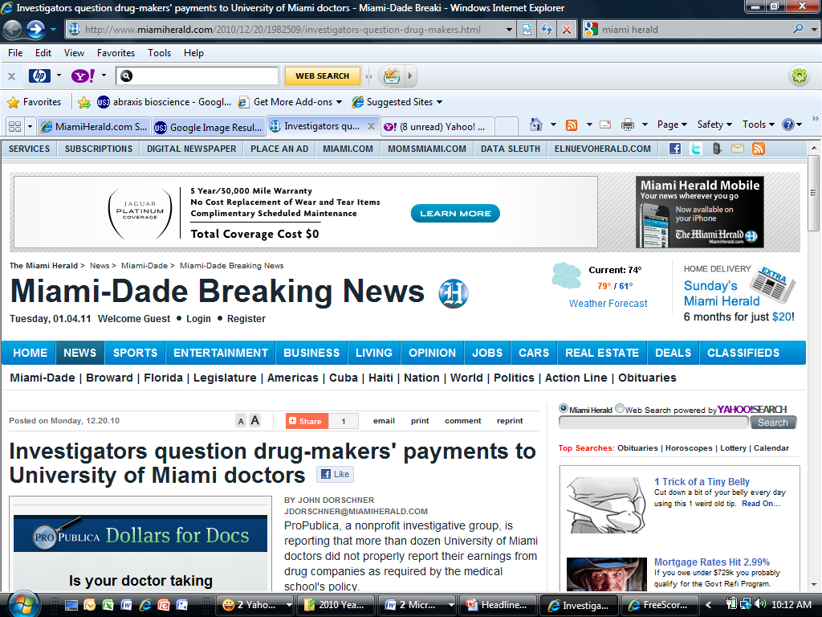
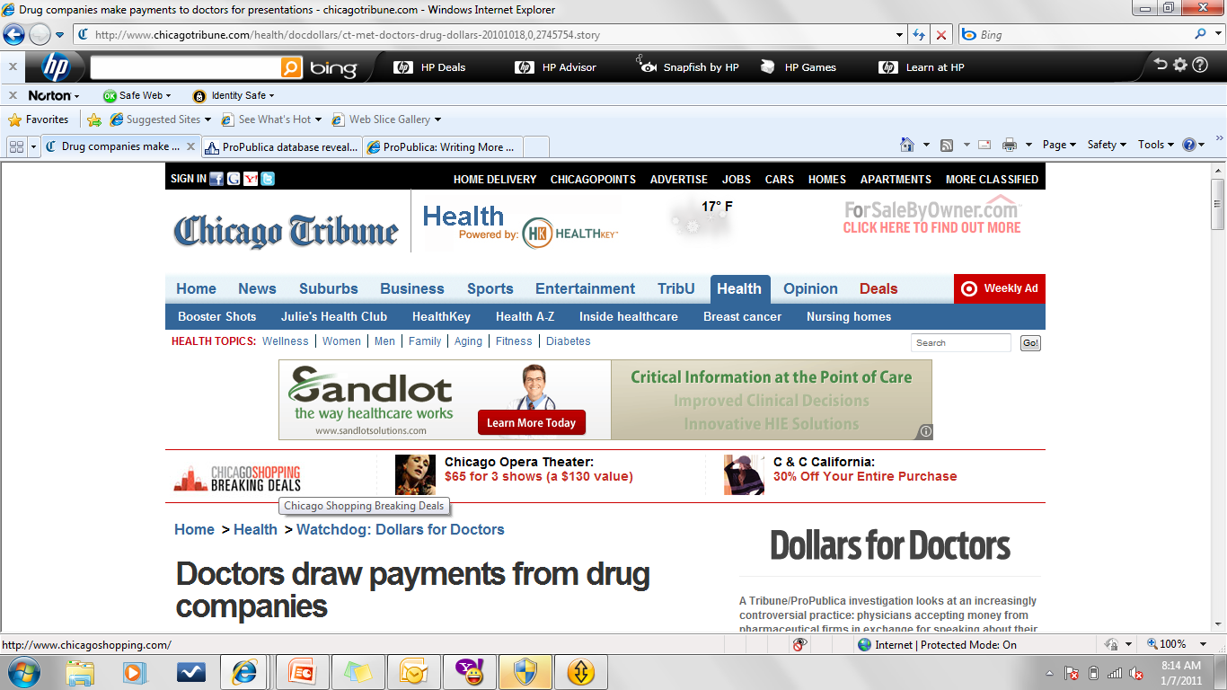
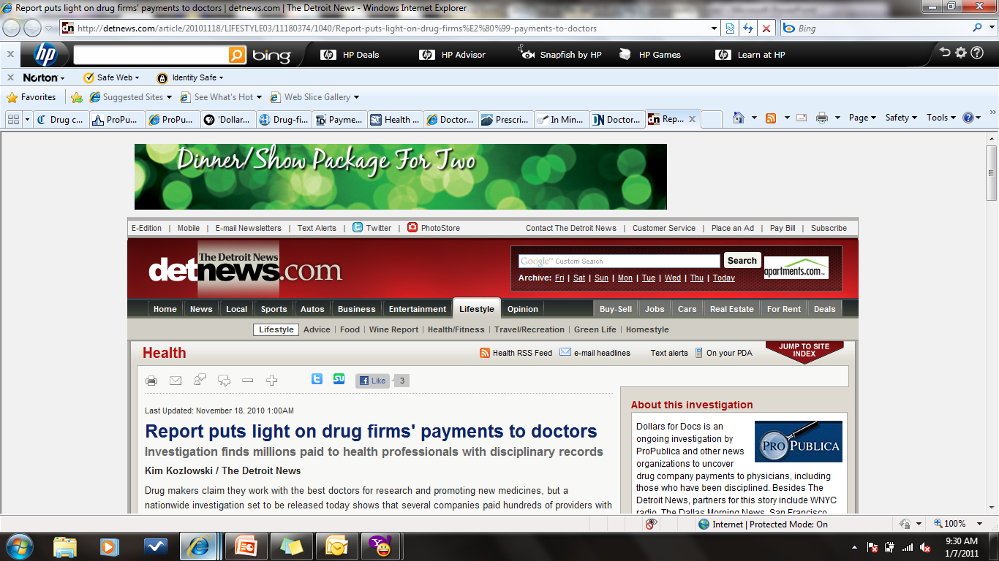
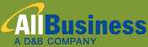
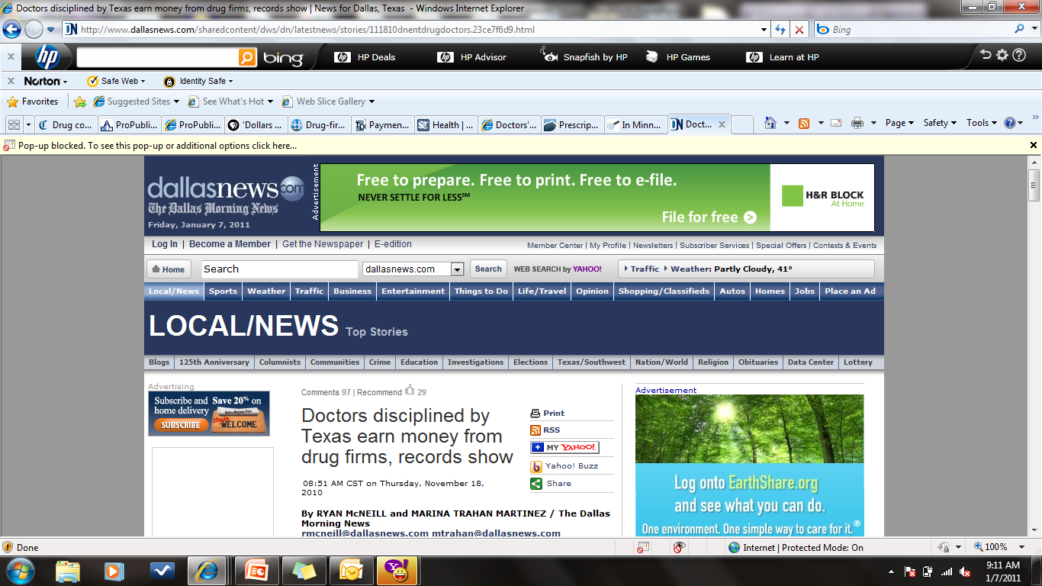
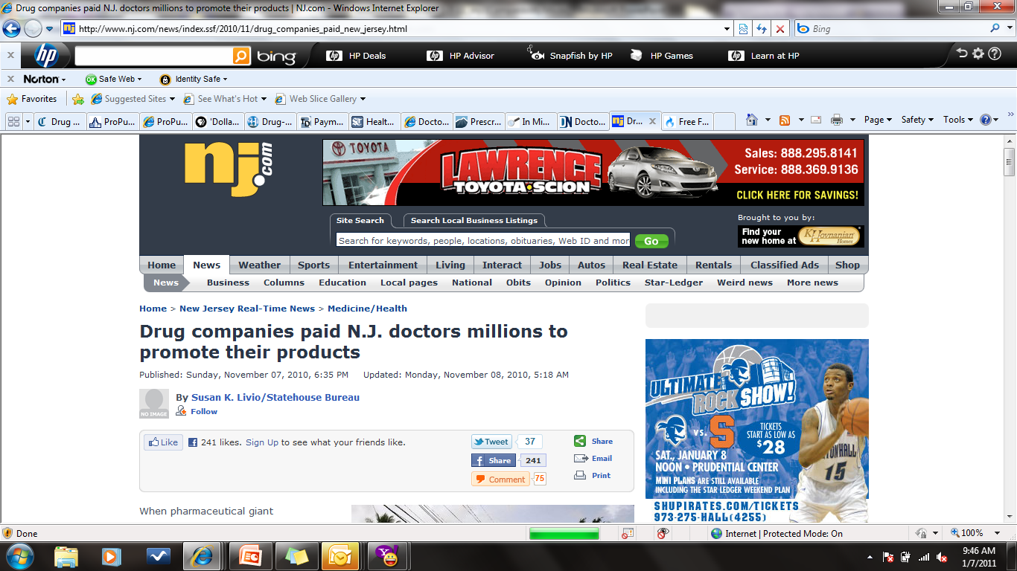
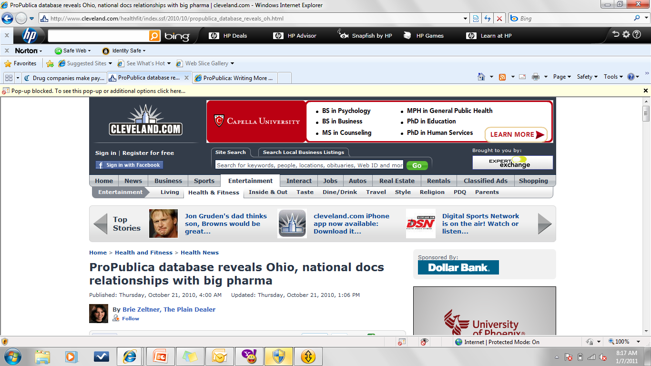
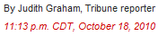
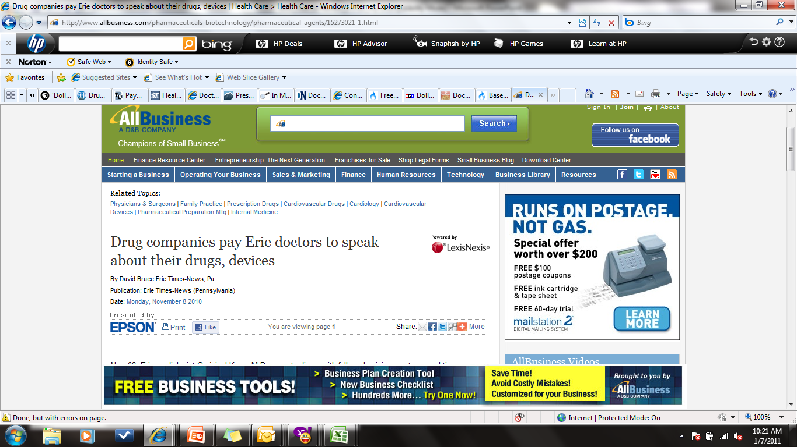
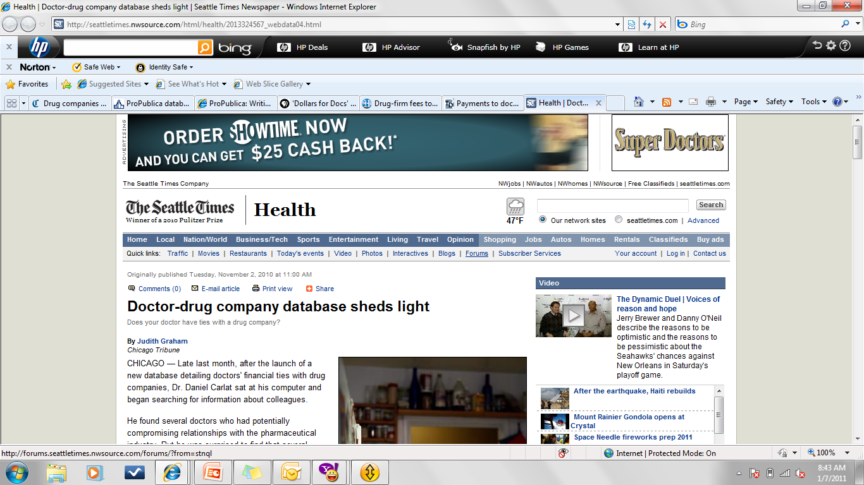
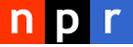
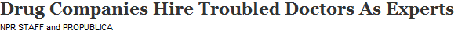
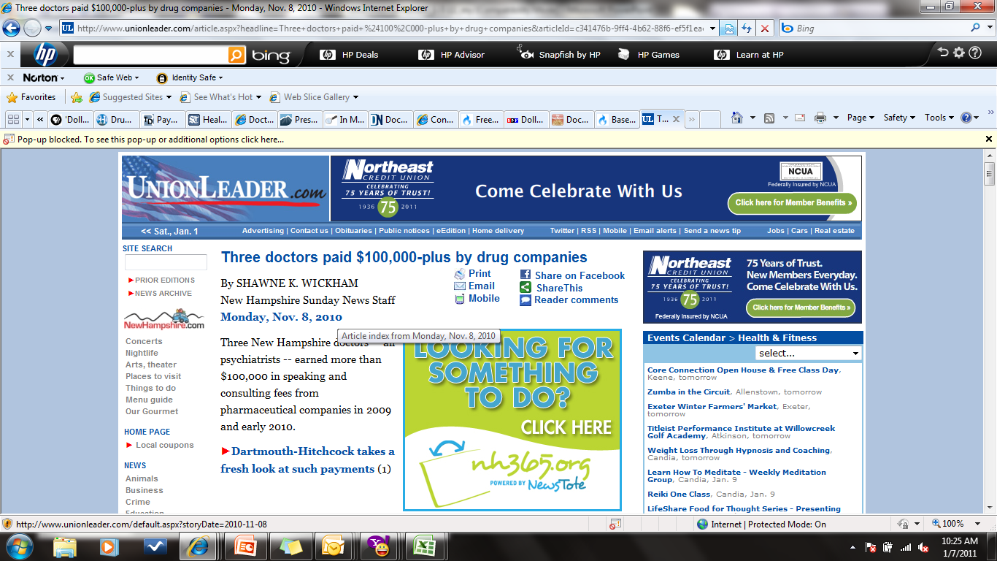
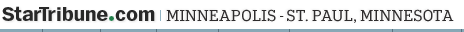
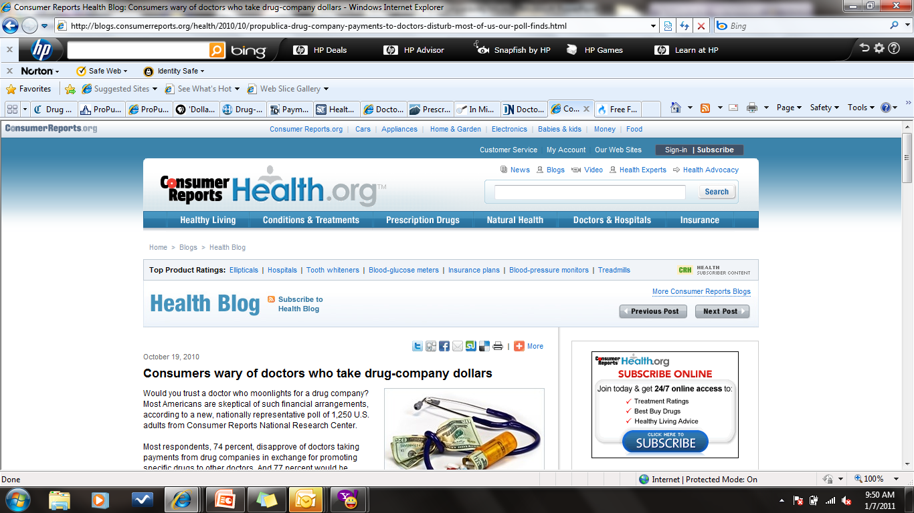
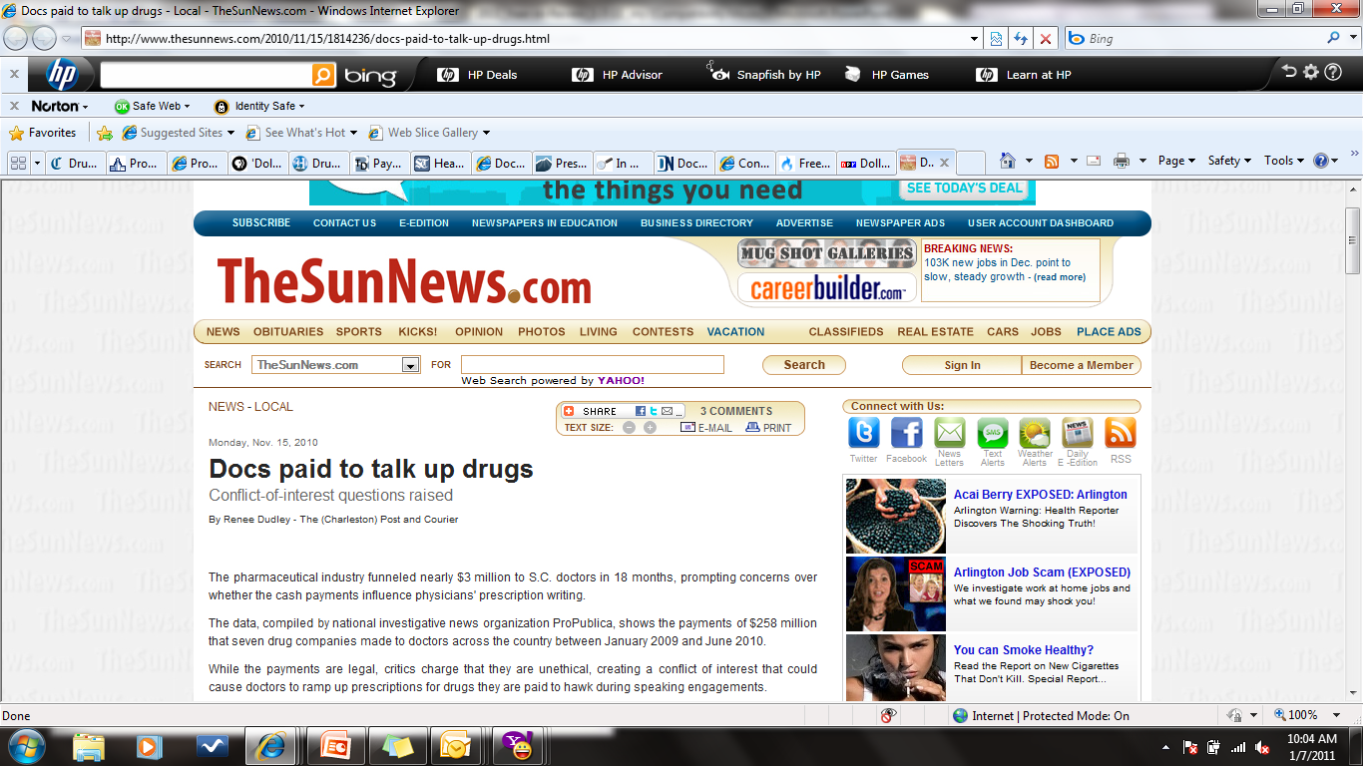
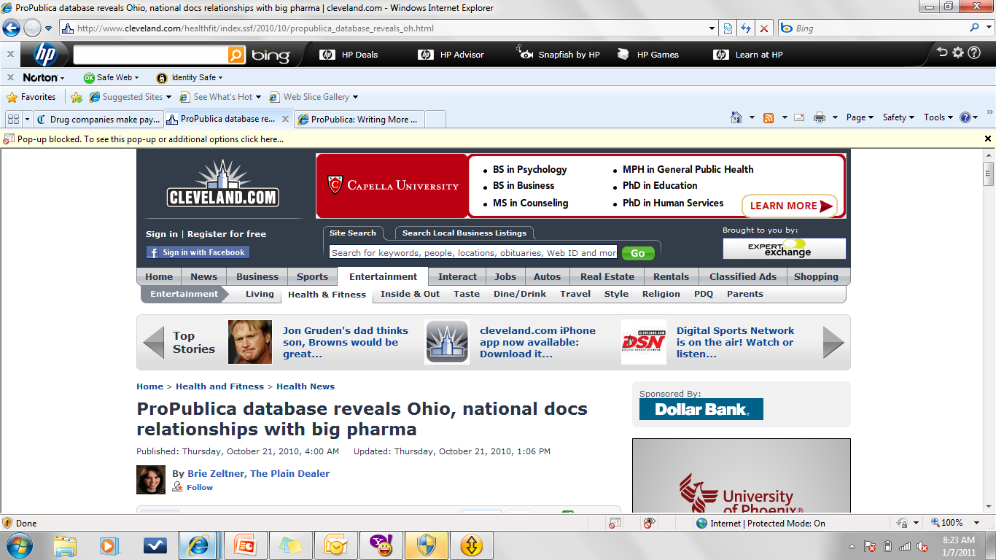

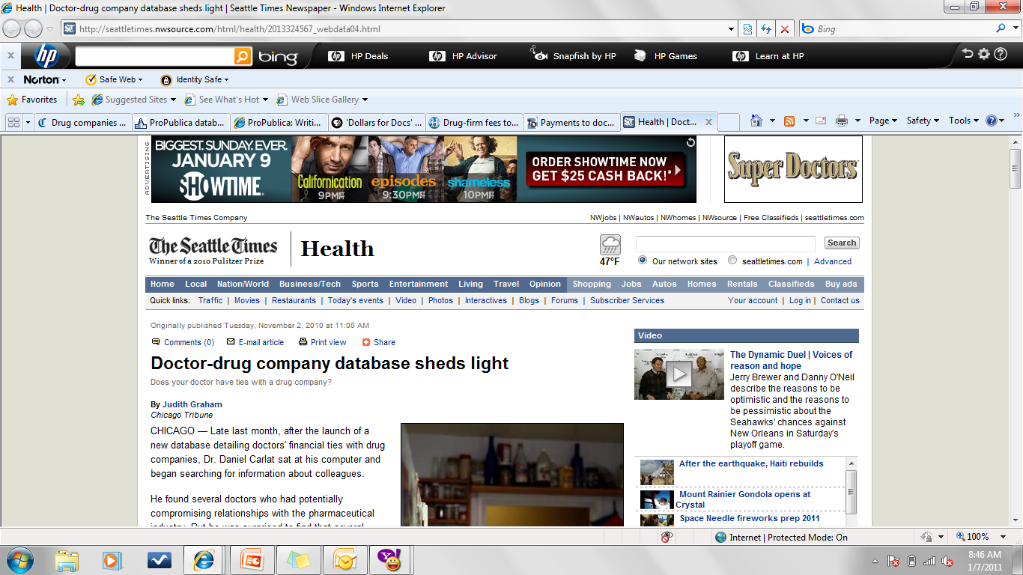
ProPublica Impacts Local News Media
Doctors disciplined by Texas earn money from drug firms, records show
October 19, 2010
October 19, 2010
—Kevin McCarthy, associate editor

Slide 44





Universities Tighten Conflicts Policies
www.potomacriverpartners.com

Slide 45
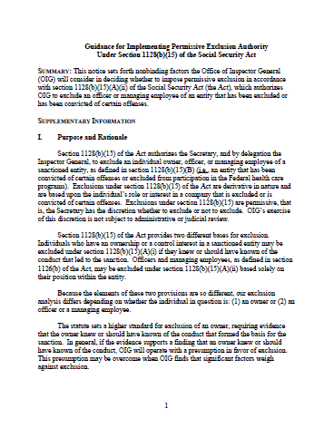
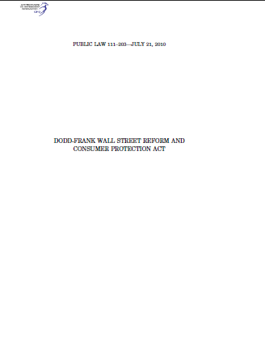
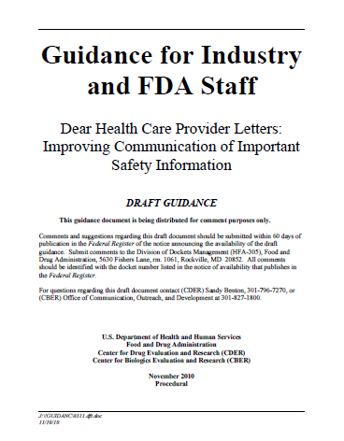
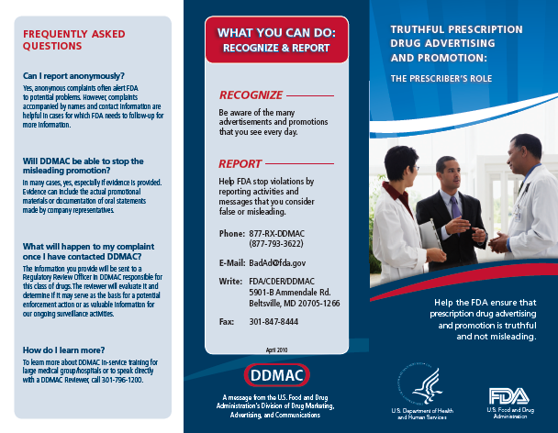
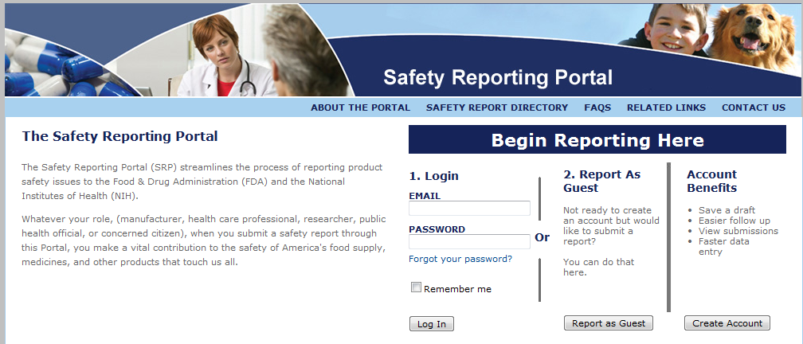
New Federal Guidance and Enforcement
  FDA Launches New Post Market Safety Registry
  Significant Increase in Warning Letters…Including Guidance on Disease State Websites and Facebook Widgets
  FDA Launches Bad Ad Program
  Dodd-Frank includes new whistleblower program
  OIG Releases Guidance for Implementing Permissive Exclusion
  FDA Drafts Dear HCP Guidance
www.potomacriverpartners.com

Slide 46

Other Key Events
GSK Announces New Incentive Compensation Model
Free Speech Defense Gains
in Off-Label Case
Roche Launches Internal Social Media Guidelines
Cephalon, J&J, Pfizer, and AZ disclose payments
High Court to Weigh Preemption for Generics
Certifications are Becoming Key
Compliance Tools
www.potomacriverpartners.com

Slide 47

International Compliance
5 Chinese officials arrested for taking bribes
Major developments in global
FCPA enforcement
ABPI members vote to increase transparency and trust by amending the UK Code of Practice
Mexico fines pharmaceutical firms
for price fixing

Slide 48

Are you ready for 2011?
www.potomacriverpartners.com

Slide 49


Sources
Federal Settlements
State Settlements
http://www.justice.gov/opa/pr/2010/February/10-civ-115.html
http://www.justice.gov/opa/pr/2009/July/09-civ-681.html
http://www.justice.gov/opa/pr/2010/April/10-civ-487.html
http://www.justice.gov/opa/pr/2010/April/10-civ-500.html
http://www.boston.com/business/healthcare/articles/2010/04/22/genzyme_expects_lingering_drug_shortage_175m_fine/
http://www.justice.gov/opa/pr/2010/April/10-civ-499.html
http://www.justice.gov/opa/pr/2010/May/10-civ-522.html
http://www.justice.gov/opa/pr/2010/September/10-civ-988.html
http://www.justice.gov/opa/pr/2010/September/10-civ-1028.html
http://www.justice.gov/opa/pr/2010/September/10-civ-1102.html
http://www.justice.gov/opa/pr/2010/February/10-civ-115.html
http://www.justice.gov /usao/pae/News/Pr/2010/Oct/synthes,norian_release.pdf?
http://www.justice.gov/opa/pr/2010/October/10-civ-1205.html
http://www.miamiherald.com/2010/11/01/1903266/ela-medical-settles-miami-whistle.html
http://www.justice.gov/opa/pr/2010/December/10-civ-1398.html
http://www.justice.gov/opa/pr/2010/December/10-civ-1398.html
http://www.justice.gov/opa/pr/2010/December/10-civ-1398.html
http://www.justice.gov/opa/pr/2010/December/10-civ-1402.html
http://www.justice.gov/opa/pr/2010/December/10-civ-1444.html
http://www.justice.gov/usao/ma/Press%20Office%20-%20Press%20Release%20Files/Dec2010/ELANstlmntPR.html
http://www.justice.gov/opa/pr/2010/December/10-civ-1464.html
http://www.mass.gov/?pageID=cagopressrelease&L=1&L0=Home&sid=Cago&b=pressrelease&f=2010_03_09_actavis_settlement_agreement&csid=Cago
http://www.doj.state.wi.us/absolutenm/templates/template_share.aspx?articleid=2216&zoneid=1
http://www.mass.gov/?pageID=cagopressrelease&L=1&L0=Home&sid=Cago&b=pressrelease&f=2010_04_27_astrazeneca_settlement&csid=Cago
https://www.oag.state.tx.us/oagNews/release.php?id=3413
http://www.mass.gov/?pageID=cagopressrelease&L=1&L0=Home&sid=Cago&b=pressrelease&f=2010_09_21_Omnicare_Settlement&csid=Cago
http://mi.michigan.gov/ag/0,1607,7-164--243869--,00.html
http://hawaii.gov/ag/main/press_releases/2010/2010-21.pdf
State Updates
http://www.masshightech.com/stories/2010/11/22/daily9-Mass-unveils-list-of-drug-maker-payments-to-doctors-hospitals.html
http://www.cga.ct.gov/2010/ACT/Pa/pdf/2010PA-00117-R00SB-00428-PA.pdf
http://www.law.com/jsp/lawtechnologynews/PubArticleLTN.jsp?id=1202464453544
http://www.businessweek.com/news/2010-11-23/ims-health-wins-court-attack-on-vermont-marketing-law.html
Animation, Music and Pictures
Licensed Through:
www.potomacriverpartners.com

Slide 50
Sources
Individual Responsibility
In The News
http://www.justice.gov/usao/pae/News/Pr/2010/Oct/synthes,norian_release.pdf
http://www.justice.gov/usao/can/press/2009/2009_09_29_harkonen.convicted.press.html
http://www.nytimes.com/2010/12/16/business/16purdue.html?_r=2
http://www.pmdcentral.com/former-sales-rep-to-argue-first-amendment-protection-in-court/article/192073/
http://www.justice.gov/usao/ma/Press%20Office%20-%20Press%20Release%20Files/Mar2009/FarinaconvictionPR.html
http://www.bloomberg.com/news/2010-11-09/u-s-charges-drug-company-lawyer-with-making-false-statements-during-probe.html
http://www.stltoday.com/business/article_bcf10fac-f1c2-11df-961b-00127992bc8b.html
http://investing.businessweek.com/research/stocks/private/snapshot.asp?privcapId=9682073
http://www.reuters.com/article/idUSN2915807520100629?rpc=401&feedType=RSS&feedName=rbssHealthcareNews&rpc=401
http://www.fda.gov/ICECI/CriminalInvestigations/ucm226466.htm
http://www.washingtontimes.com/news/2010/nov/11/drug-firm-paid-athletes-as-bait-to-pitch-products/
http://www.nytimes.com/2010/11/30/business/30drug.html
http://abcnews.go.com/GMA/OnCall/childrens-tylenol-recall-fda-report-rips-quality-control/story?id=10558014
http://www.law.com/jsp/article.jsp?id=1202446920424
http://www.usatoday.com/news/health/2010-05-26-drug-factories-warned_N.htm
http://blogs.wsj.com/health/2010/01/25/harvard-doc-steps-down-to-keep-drug-industry-speaking-gig/
ProPublica Stories
An Update from The Hill
http://www.thesunnews.com/2010/11/15/1814236/docs-paid-to-talk-up-drugs.html
http://www.nj.com/news/index.ssf/2010/11/drug_companies_paid_new_jersey.html
http://www.startribune.com/business/111704609.html
http://seattletimes.nwsource.com/html/health/2013324567_webdata04.html?prmid=related_stories_section
http://blogs.consumerreports.org/health/2010/10/propublica-drug-company-payments-to-doctors-disturb-most-of-us-our-poll-finds.html
http://www.allbusiness.com/pharmaceuticals-biotechnology/pharmaceutical-agents/15273021-1.html
http://www.kaiserhealthnews.org/Daily-Reports/2010/October/22/grassley-on-Medicare.aspx
http://www.phrma.org/news/news/phrma_statement_regarding_fda%E2%80%99s_drug_safety_oversight
http://www.pbs.org/nbr/site/features/special/archives/pharmaceutical_companies/final_health_care_push_100319/
http://www.businessweek.com/news/2010-07-02/u-s-house-approves-restrictions-on-brand-name-drug-agreements.html
www.potomacriverpartners.com

Slide 51

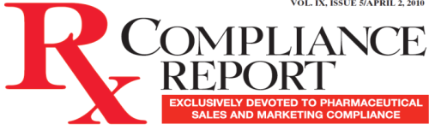
Sources
New Federal Guidance and Development
http://articles.chicagotribune.com/2010-10-18/business/ct-met-doctors-drug-dollars-20101018_1_drug-companies-medical-professionals-influence-doctors
http://www.unionleader.com/article.aspx?headline=Three+doctors+paid+%24100%2C000-plus+by+drug+companies&articleId=c341476b-9ff4-4b62-88f6-ef5f1eac06a8
http://www.npr.org/templates/story/story.php?storyId=130644774
http://www.dallasnews.com/sharedcontent/dws/dn/latestnews/stories/111810dnentdrugdoctors.23ce7f6d9.html
http://www.cleveland.com/healthfit/index.ssf/2010/10/propublica_database_reveals_oh.html
http://www.propublica.org/article/in-minnesota-drug-company-reports-of-payments-to-doctors-mistaken
http://detnews.com/article/20101118/LIFESTYLE03/11180374/Report-puts-light-on-drug-firms%E2%80%99-payments-to-doctors
http://www.miamiherald.com/2010/12/20/1982509/investigators-question-drug-makers.html
http://www.syracuse.com/news/index.ssf/2010/11/drug_makers_pay_51_central_new.html
http://www.postandcourier.com/news/2010/nov/14/doctors-paid-talks-in-question/
http://www.pbs.org/newshour/rundown/2010/10/dollars-for-docs-tracks-pharmaceutical-companies-spending.html
www.govtrack.us/congress/bill.xpd?bill=h111-4173
http://www.fda.gov/NewsEvents/Newsroom/PressAnnouncements/ucm211611.htm
http://www.fda.gov/downloads/Drugs/GuidanceComplianceRegulatoryInformation/Guidances/UCM233769.pdf
http://www.fda.gov/NewsEvents/Newsroom/PressAnnouncements/ucm213221.htm
http://www.fda.gov/Drugs/GuidanceComplianceRegulatoryInformation/EnforcementActivitiesbyFDA/WarningLettersandNoticeofViolationLetterstoPharmaceuticalCompanies/default.htm
Other Key Events
GSK announces new compensation program for U.S. sales reps, Rx Compliance Report, July 20, 2010
Certifications are becoming key compliance tool for pharma companies, say senior compliance officers, Rx Compliance Report, March 16, 2010
http://blogs.forbes.com/docket/2010/12/01/doj-shows-concern-over-pending-off-label-speech-case/?partner=yahootix
http://www.roche.com/socialmedia
http://www.cephalon.com/healthcare-professionals/healthcare-professionals.shtml
http://online.wsj.com/article/SB10001424052748704111704575355350519993626.html
http://www.nytimes.com/2010/04/01/business/01payments.html?_r=1&adxnnl=1&adxnnlx=1294934509-wlc4lJBDrObSjRT0xc4nNw
http://www.npr.org/blogs/health/2009/05/astrazeneca_joins_big_pharma_d.html
http://www.reuters.com/article/idUSN1012728820101210
Universities Tighten Conflicts Policies
http://www.nytimes.com/2010/01/03/health/research/03hospital.html?_r=1 Harvard – go with this one
http://www.pharmalot.com/2010/09/yale-medical-group-tightens-conflicts-policy/
http://www.nytimes.com/2010/03/22/health/policy/22docs.html
http://www.jsonline.com/features/health/48692952.html
http://policy.umn.edu/Policies/Operations/Compliance/CONFLICTINTEREST_APPA.html
www.potomacriverpartners.com

Slide 52

Content And Graphics By:
A specialized management consulting firm exclusively focused on healthcare compliance
Policies and Procedures
Training
Auditing & Monitoring
Aggregate Spend
Jon Wilkenfeld
President
Tel: 703.430.5944
Cell: 610.470.7616
Fax: 703.997.7719
jwilkenfeld@potomacriverpartners.com
www.potomacriverpartners.com
www.potomacriverpartners.com

